Slide 1
Unsupervised Learning
Cluster Analysis & Anomaly Detection
Data Analytics, Predictive Analytics & Data Mining
Gannon University | Dahlkemper School of Business | Spring 2026

Slide 2


The Big Picture
Supervised Learning
Unsupervised Learning
"Based on what I know, what will happen next?"
Has a target variable (label)
Predicts outcomes
Classification & Regression
Example: Will this customer churn?
"What patterns exist that I haven't seen yet?"
No target variable
Discovers hidden structure
Clustering & Anomaly Detection
Example: What customer groups exist?
One predicts. The other discovers.

Slide 3


Two Techniques We'll Cover
Cluster Analysis
Anomaly Detection
"Who are they?"
"What doesn't belong?"
Finds natural groups in data. Used for customer segmentation, market research, and patient subgrouping.
Identifies unusual observations. Used for fraud detection, quality control, and network security.

Slide 4



What Makes a Good Cluster?
High Intra-Cluster Similarity
High Inter-Cluster Difference
Members within the same cluster should be very similar to each other.
Members in different clusters should be clearly distinct from each other.
Think about customer segments at a grocery store. A useful segmentation separates "budget-conscious families" from "health-focused singles" from "premium foodies." Each group is internally consistent, and the groups are meaningfully different.

Slide 5
K-Means Clustering: How It Works
1
2
3
4
5
Choose K
Place Centroids
Assign Points
Recalculate
Repeat
Decide how many clusters you want
Randomly place K cluster centers
Each point goes to nearest centroid
Update centroids as group averages
Until assignments stop changing
Centroid = the "prototype" or most typical member of each cluster. It represents the average values for all attributes in that group.

Slide 6
Choosing K: The Elbow Method
How It Works
1. Run K-Means for K = 1, 2, 3...
2. Record WCSS for each K
3. Plot K vs. WCSS
4. Find the "elbow" where improvement slows
Business sense trumps math. 47 segments? Nobody can use that. Aim for 3-8 interpretable groups.

Slide 7
Evaluating Cluster Quality
Silhouette Score
Elbow Method
Business Validation
-1 to +1
WCSS
Stakeholder Test
How similar each point is to its own cluster vs. the nearest other. Above 0.5 is generally good.
Total within-cluster variance. Look for the elbow where adding clusters stops helping much.
Show clusters to a stakeholder and ask: "Can you name each group and act on them differently?"

Slide 8
Note:
In SAS Visual Analytics (VA), the Within-Cluster Sum of Squares (WCSS) is not always labeled as "WCSS" in the interface. Instead, it is typically presented as the Symmetric Log Iteration Plot or found within the Details Table under specific statistical names.
In Python, calculating and visualizing the Within-Cluster Sum of Squares (WCSS) is a standard part of the KMeans workflow, typically using the sklearn library. While SAS Visual Analytics hides some of the math in the "Details Table," Python gives you direct access to this value via the inertia_ attribute.

Slide 9
For business students, the goal isn't just to "do the math"—it's to be the translator between the algorithm and the boardroom.
Below is the definitive "Top of Head" checklist for business students. It covers the technical basics, with business logic required to pass an interview or lead a project.

Slide 10
1. The Strategy: STP Framework
You must know that clustering is the "S" in the STP (Segmentation, Targeting, Positioning) marketing model.
The Goal: It’s not just about "grouping"; it’s about finding Actionable Segments.
The Test: If you can't name the cluster (e.g., "Budget-Conscious Students") or reach them via a specific channel (e.g., Instagram ads), the cluster is useless for business.

Slide 11
2. The Golden Variables: RFM Analysis
In the business world, 90% of clustering starts with RFM. You should know these three variables by heart:
Recency: How recently did they buy? (Highest predictor of future purchase).
Frequency: How often do they buy? (Measures loyalty).
Monetary: How much have they spent in total? (Measures lifetime value).

Slide 12
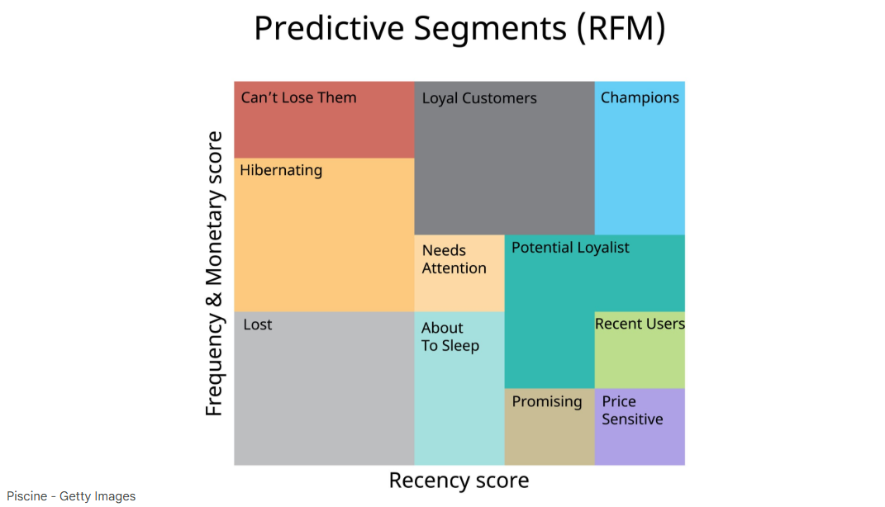

Slide 13
3. The Technical "Must-Haves"
Unsupervised Learning: No "ground truth" or "correct" answer exists; we are discovering patterns, not predicting a known label.
The Distance Metric: K-Means uses Euclidean Distance (straight-line distance). You should know that if variables aren't on the same scale (e.g., Age 0–100 vs. Income $0–$1,000,000), the "bigger" number will break the model.
Centroids: Each cluster has a "center" (the average profile). Business students should be able to describe a cluster by its centroid (e.g., "Our average 'Champion' customer spends $500 every 2 weeks").

Slide 14
4. The "Elbow" vs. The "Boardroom"
Students should know how to pick the number of clusters ($k$):
Statistical Side: Use the Elbow Method (WCSS/Inertia) or SAS’s ABC Criterion to find where adding more clusters stops providing a big "bang for your buck."
Business Side: Even if the "elbow" says 10 clusters, if the marketing team only has the budget for 3 different email campaigns, you pick $k=3$. Reality trumps math.

Slide 15
5. Implementation Realities
Scaling: In Python, you must manually use StandardScaler. In SAS VA, it’s often handled for you, but you should still check.
Outliers: One "Whale" (a customer who spends $10M) can pull a centroid so far that everyone else gets lumped into one giant, useless group. You often have to remove outliers before clustering.

Slide 16
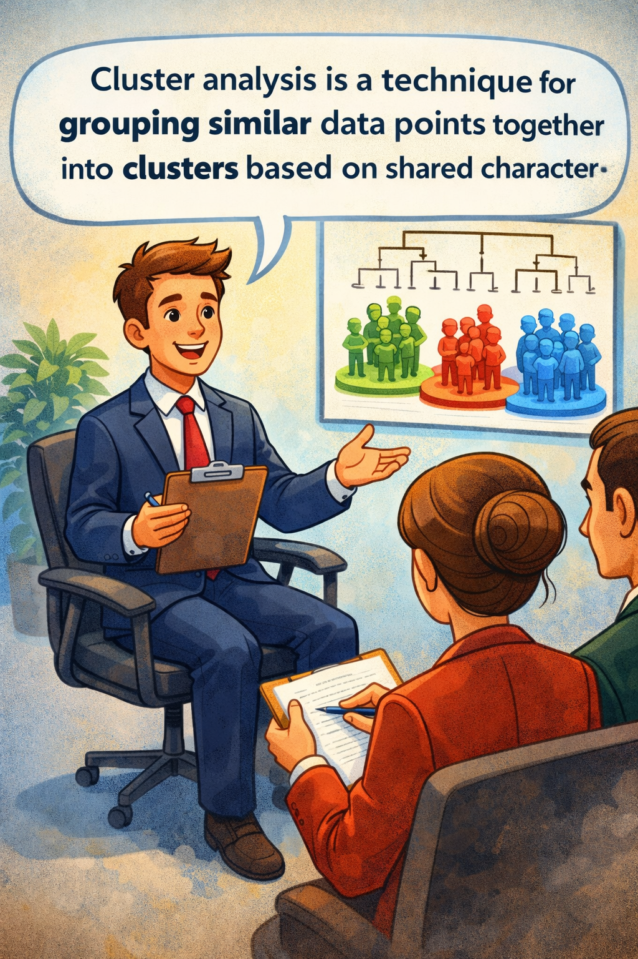
The "Elevator Pitch" Summary
If you’re asked about Cluster Analysis in an interview, you should something say:
"Cluster analysis is an unsupervised tool used for customer segmentation. I use it to find natural groups based on variables like RFM. I always standardize my data first so one variable doesn't dominate, use the Elbow Method for a statistical baseline, but ultimately select a number of clusters that is actionable for our marketing budget."

Slide 17
Anomaly Detection
Finding what doesn't belong
Point Anomaly
Contextual Anomaly
Collective Anomaly
A single data point far from the rest
Normal in one context, unusual in another
A group of points anomalous together
Example: $15,000 charge when average is $50
Example: 90°F temperature in January vs. July
Example: 10 small transactions from 10 cities in 10 min

Slide 18


Anomaly Detection Approaches
Statistical Methods
Z-scores, IQR method. Simple and fast. Best for normally distributed data with clear outliers.
One-Class SVM
Learns boundary of "normal" data. Prediction = 1 (typical) or 0 (anomalous). Powerful when labeled anomalies are scarce.
Clustering-Based
Build clusters, then flag points with low membership probability. Two-for-one: segments + anomalies from same analysis.
In practice, the best systems combine multiple methods. Banks use statistical rules for obvious fraud, clustering for patterns, and One-Class SVM for subtle anomalies.

Slide 19
Business Applications
Industry | Clustering Use Case | Anomaly Detection Use Case
Financial Services | Customer segmentation for product offers | Flagging fraudulent transactions
Healthcare | Grouping patients by treatment response | Detecting abnormal vital signs
Retail | Market basket segmentation | Identifying inventory shrinkage
Manufacturing | Product quality grouping | Sensor anomaly monitoring
Cybersecurity | User behavior profiles | Network intrusion detection

Slide 20
The PAIR Framework
Connecting Unsupervised Learning to Business Decisions
P
Pattern
e.g., 5 distinct customer segments
What did the algorithm discover?
A
Action
e.g., Targeted campaigns per segment
What will the business do differently?
I
Impact
e.g., 15% increase in email click-through
What is the expected business value?
R
Risk
e.g., Segments may shift over time
What could go wrong?
Lead with the Action and Impact when presenting to stakeholders. They care less about the algorithm and more about what to do next.

Slide 21
Key Takeaways
1
Unsupervised learning discovers patterns without a target variable
2
Always standardize your data before clustering
3
Use the Elbow Method + business judgment to choose K
4
Anomaly detection flags unusual observations for investigation, not automatic action
5
The best models combine technical rigor with business relevance (use PAIR)
Remember: It's not about the algorithm. It's about making smarter business decisions.

