Slide 1
Classification
Logistic Regression & Decision Tree

Slide 2
Basic Groups
Regression -> continuous outcomes
Classification -> categorical outcomes
Clustering -> no outcome variable

Slide 3
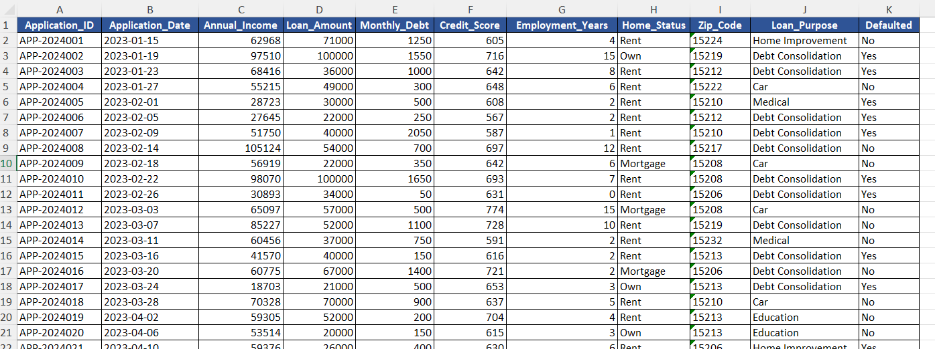
Historical, Labeled Data
Training Data
Answer keys (Y)

Slide 4
a
+
b1 X1
b2 X2
b3 X3
b4 X4
b5 X5
…
Y

Slide 5
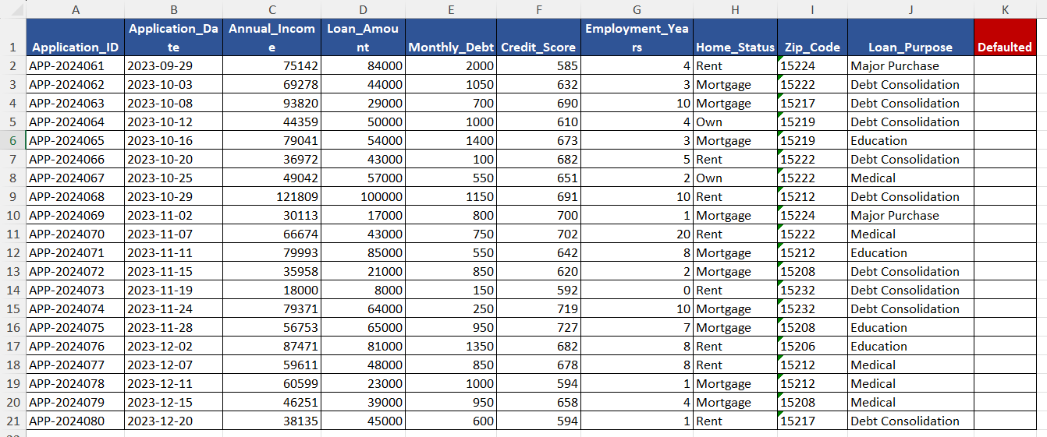
New cases

Slide 6
Week 6 Page
Analytics Technique Navigator
Model Selection Challenge

Slide 7
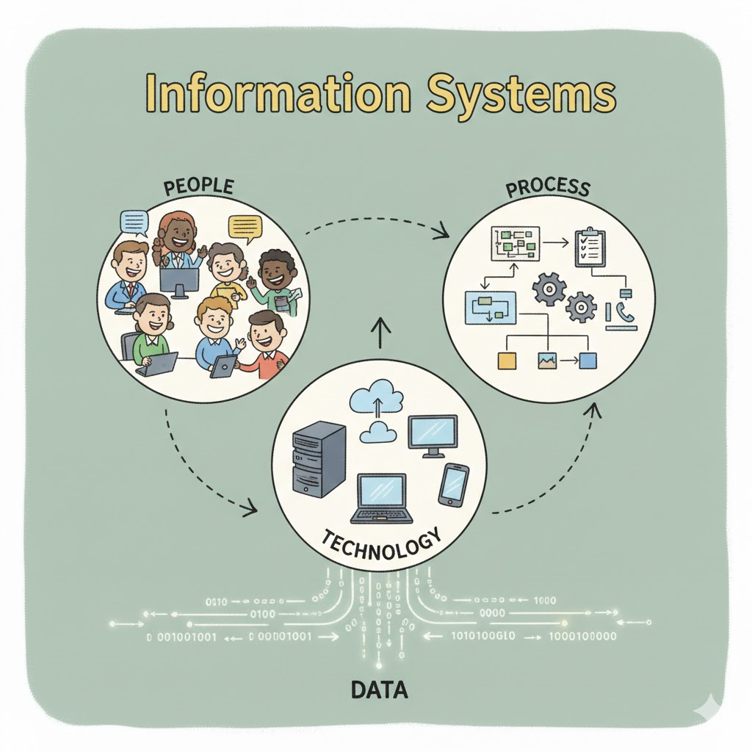

Slide 8
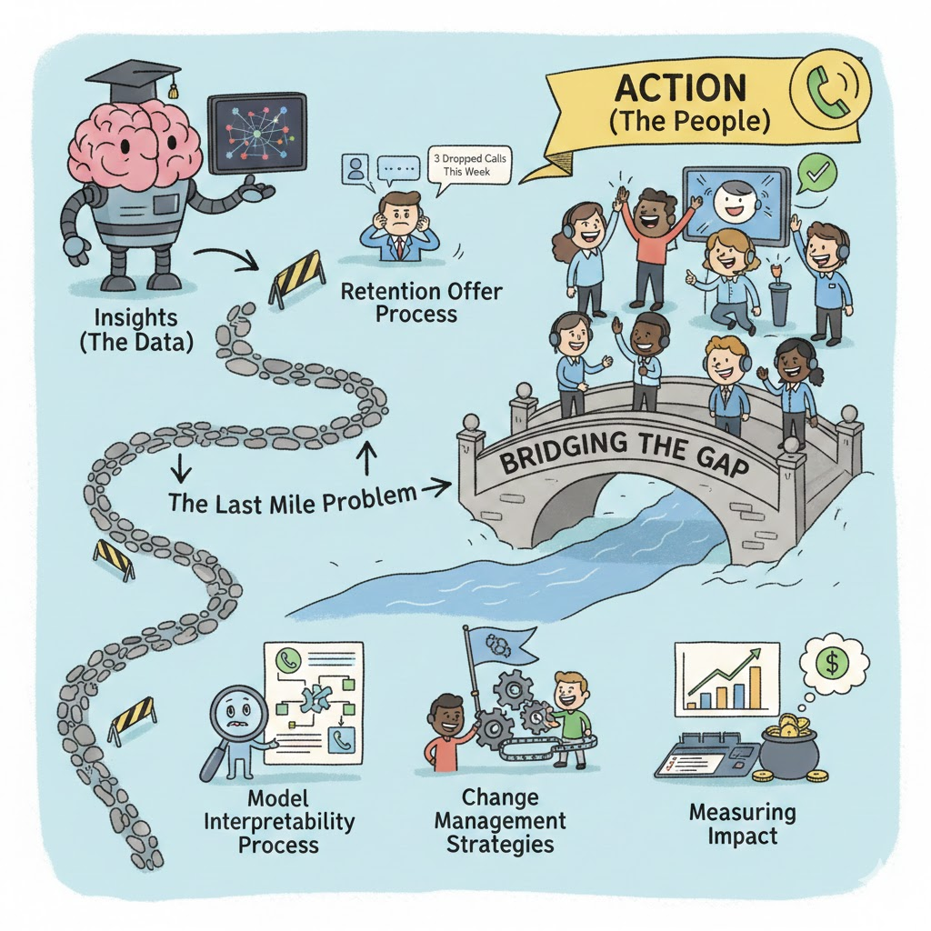

Slide 9


Slide 10


Slide 11


Slide 12
Part 1. From Linear Regression to Classification (Logistic Regression & Decision Tree)

Slide 13
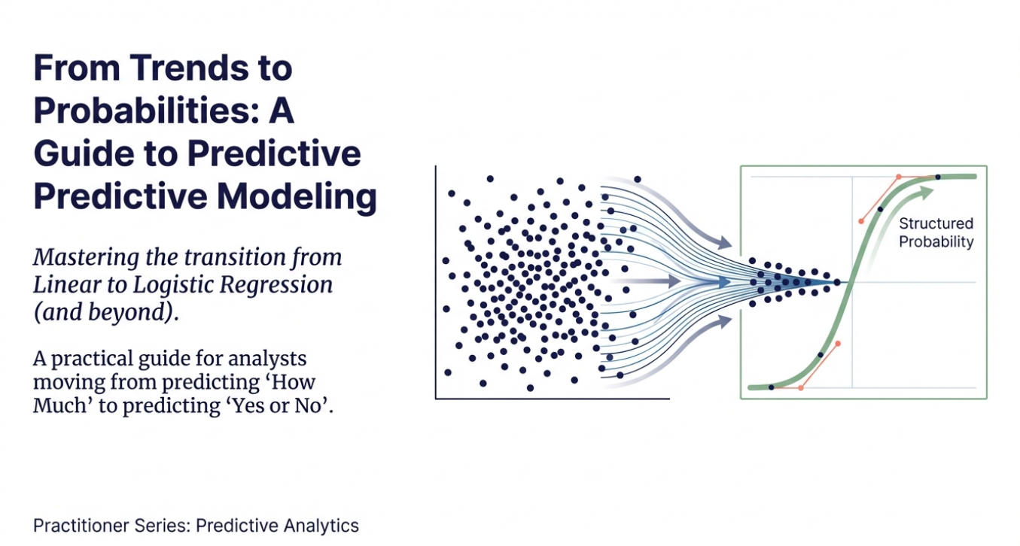

Slide 14
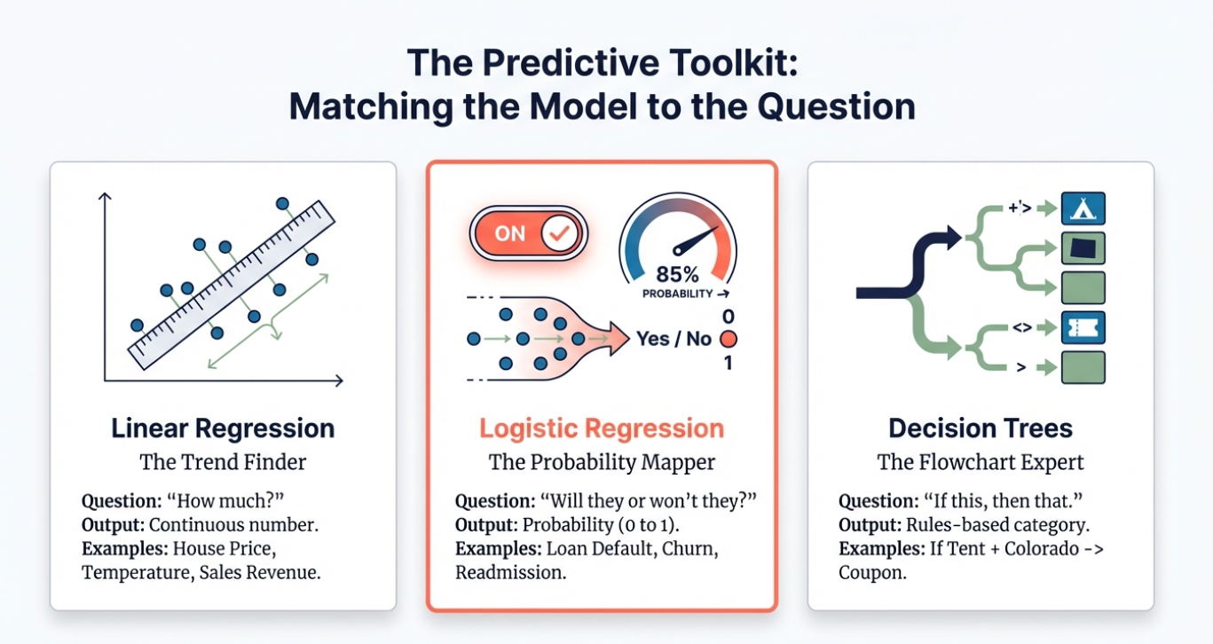

Slide 15
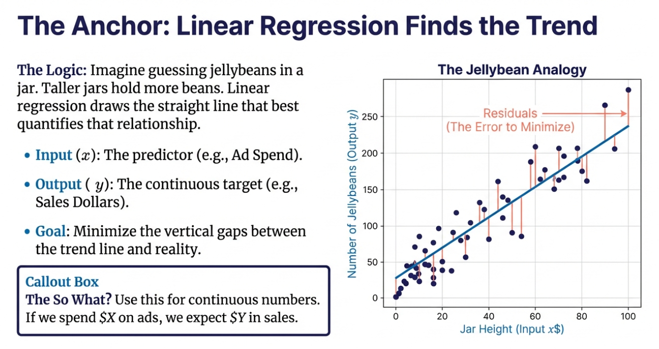

Slide 16
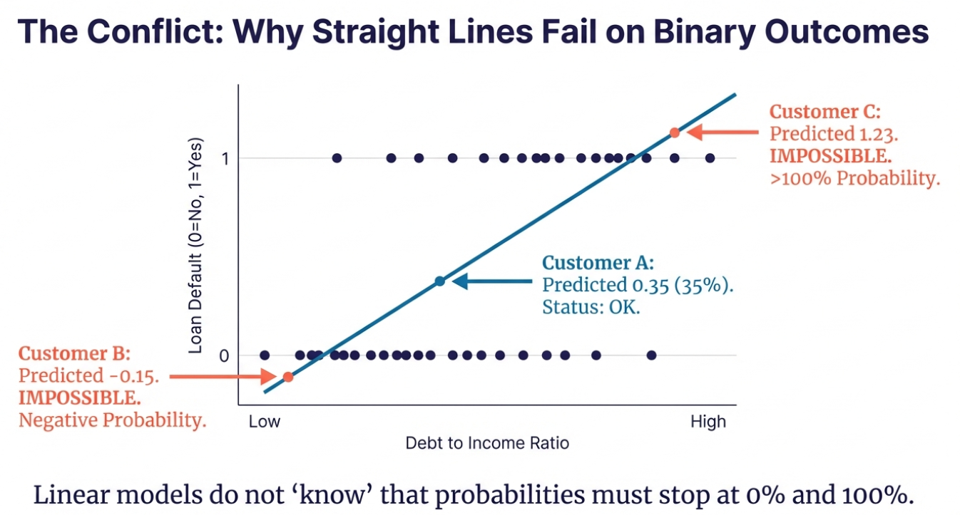

Slide 17
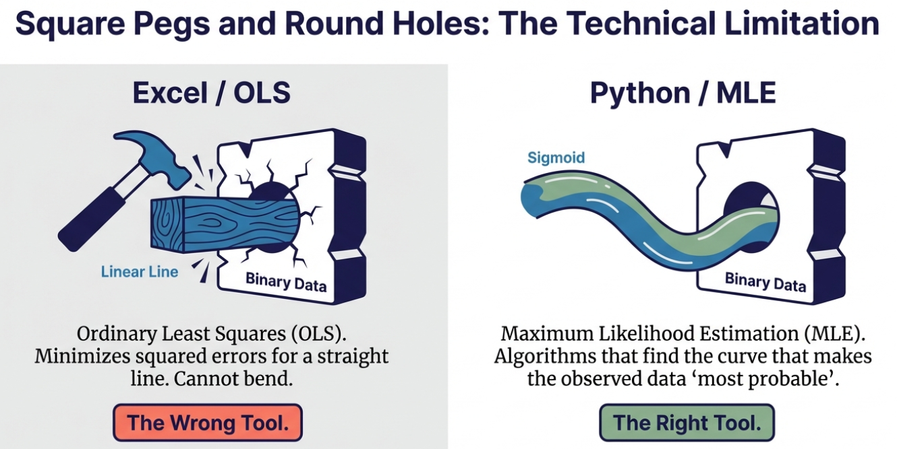
Excel draws lines. Classification requires curves. You cannot force OLS to do MLE’s job.

Slide 18
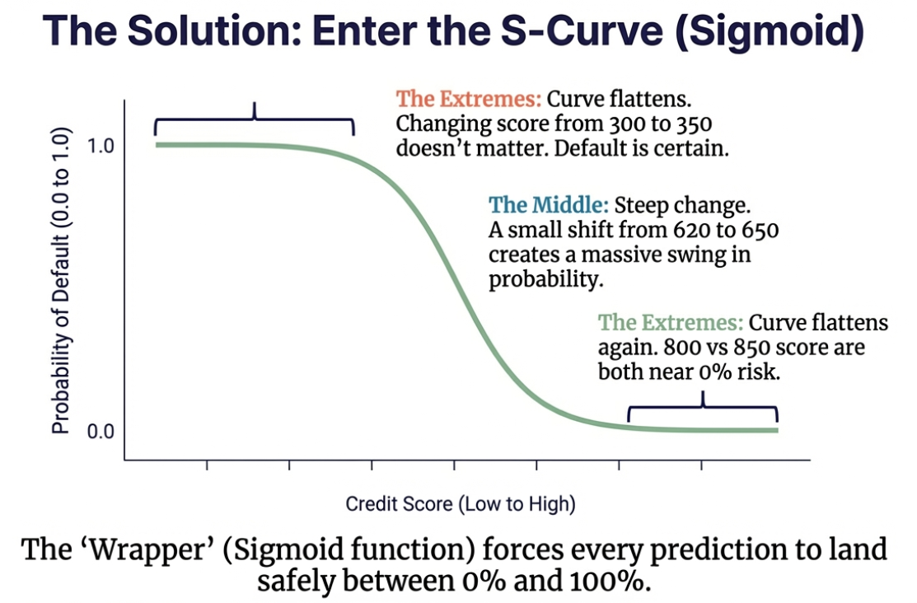

Slide 19
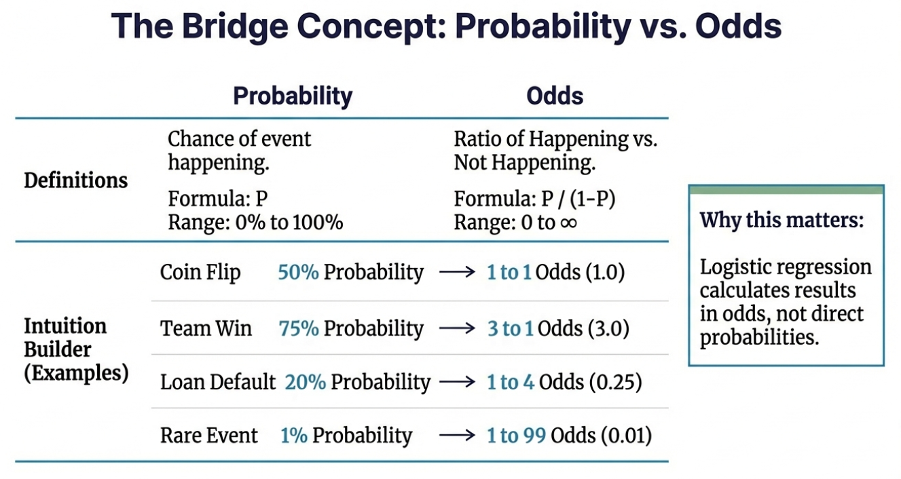

Slide 20
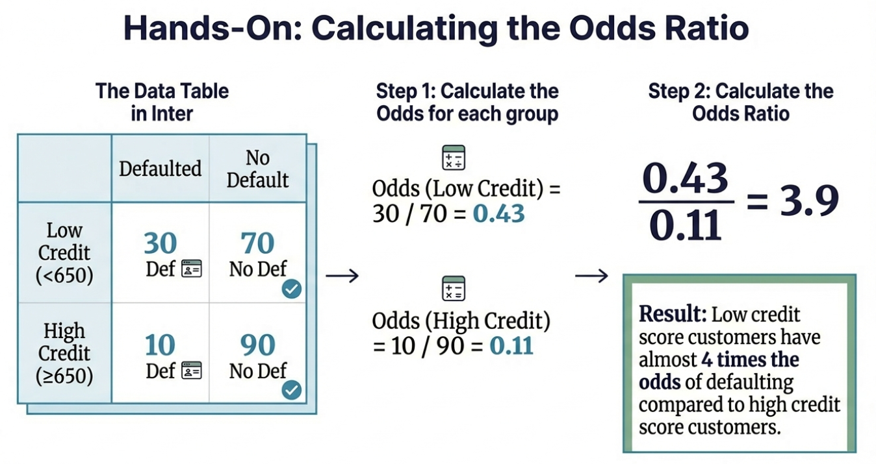

Slide 21
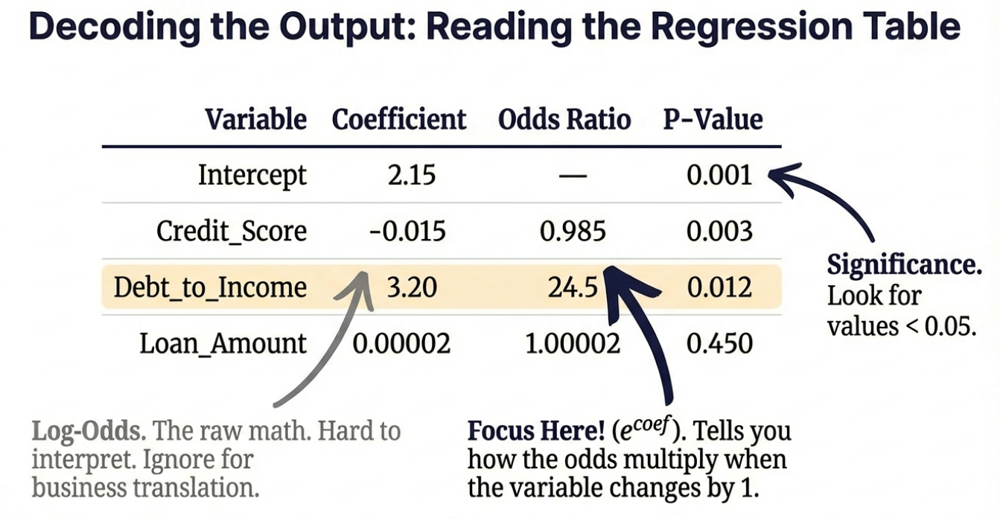

Slide 22
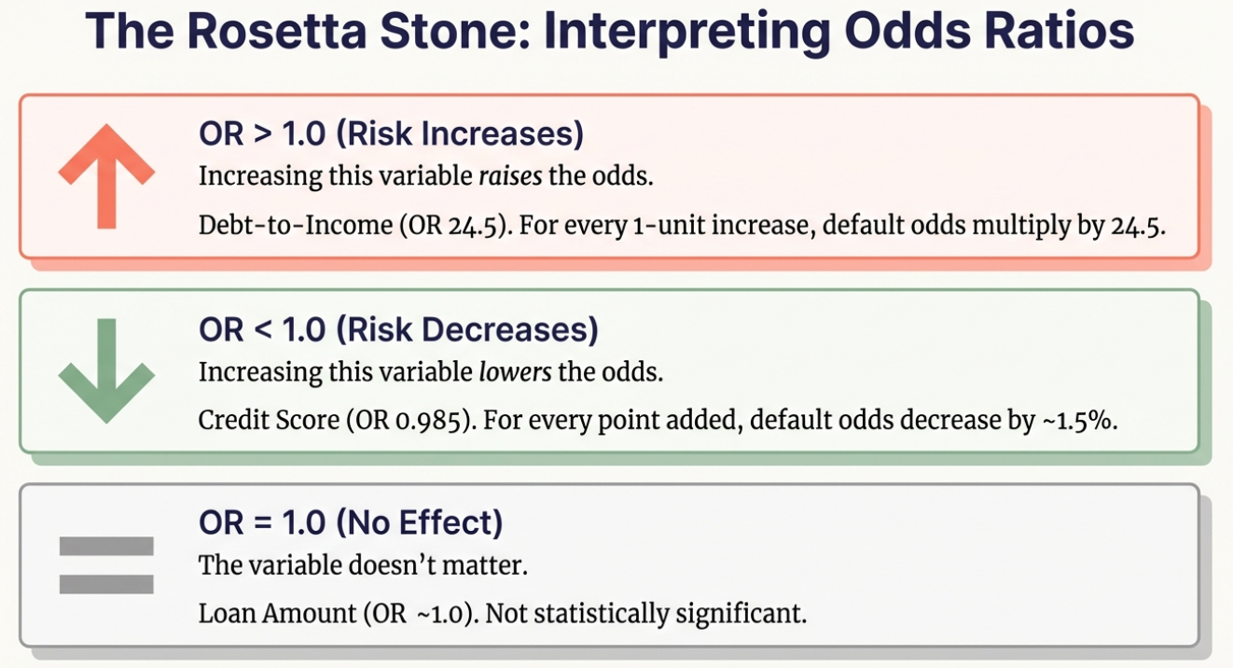

Slide 23
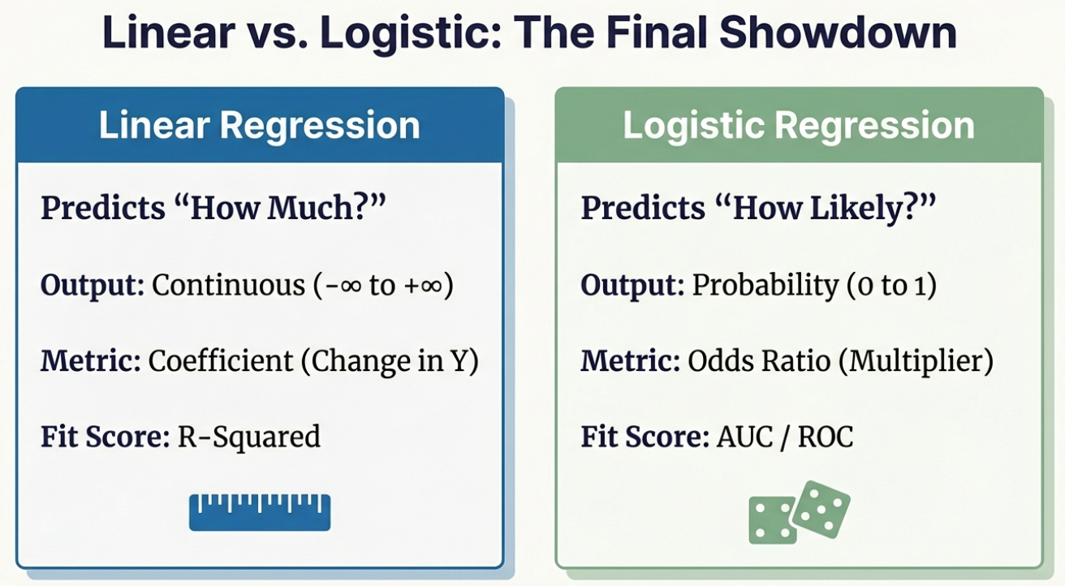

Slide 24
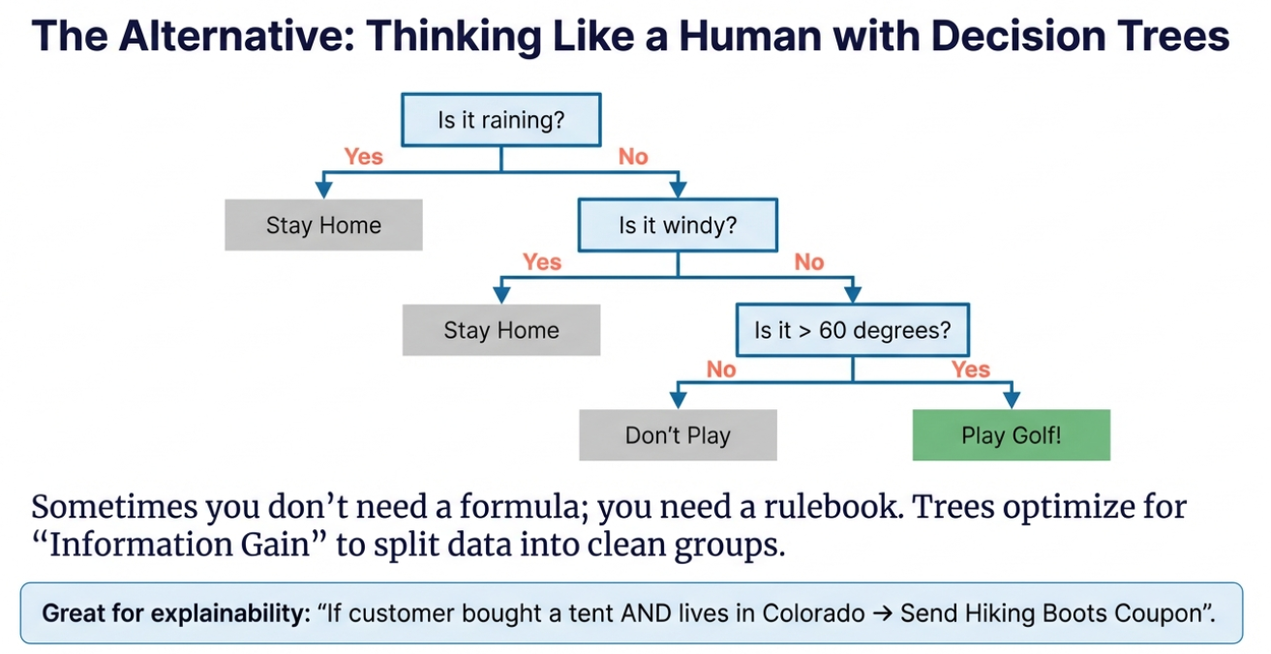

Slide 25
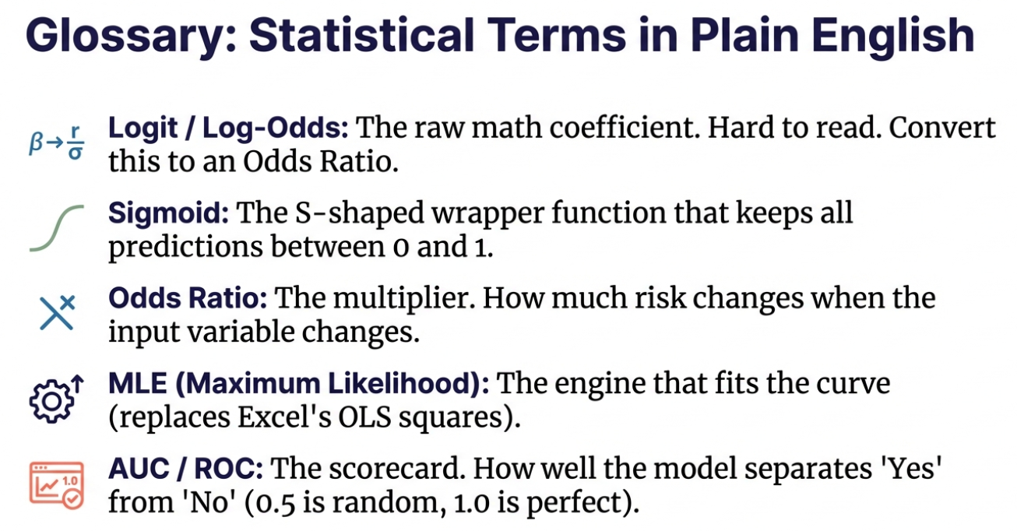

Slide 26
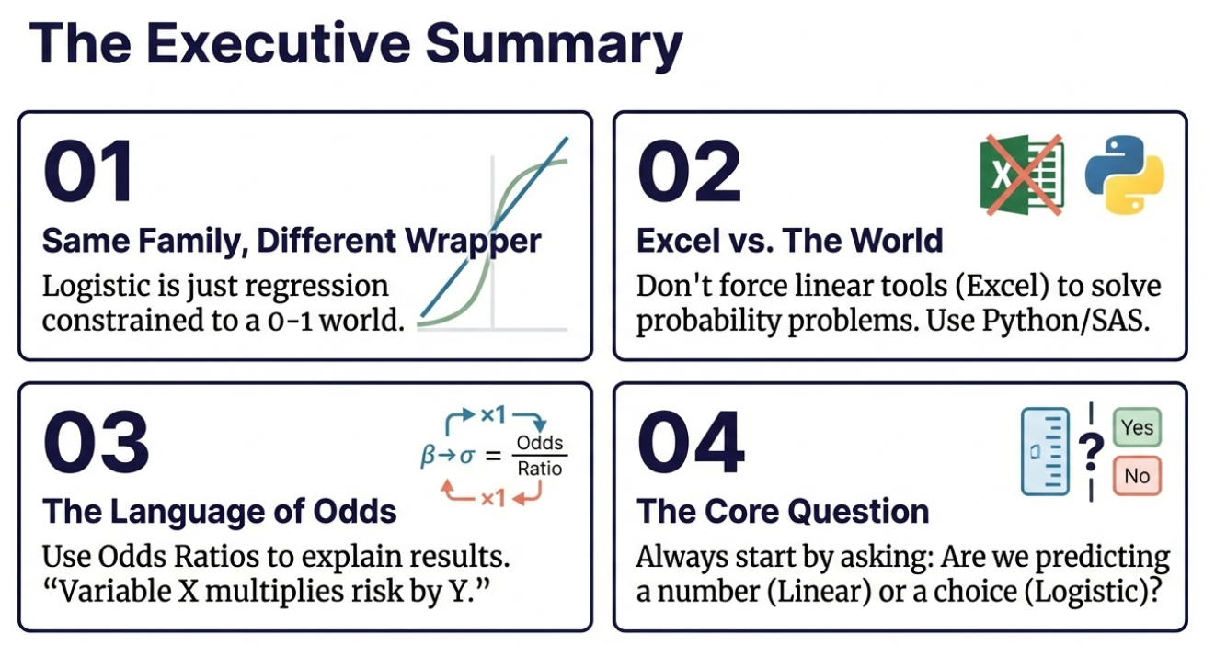

Slide 27
Week 6 Page
Analytics Technique Navigator
Model Selection Challenge

Slide 28
Part 2. Applications in Different Industries

Slide 29
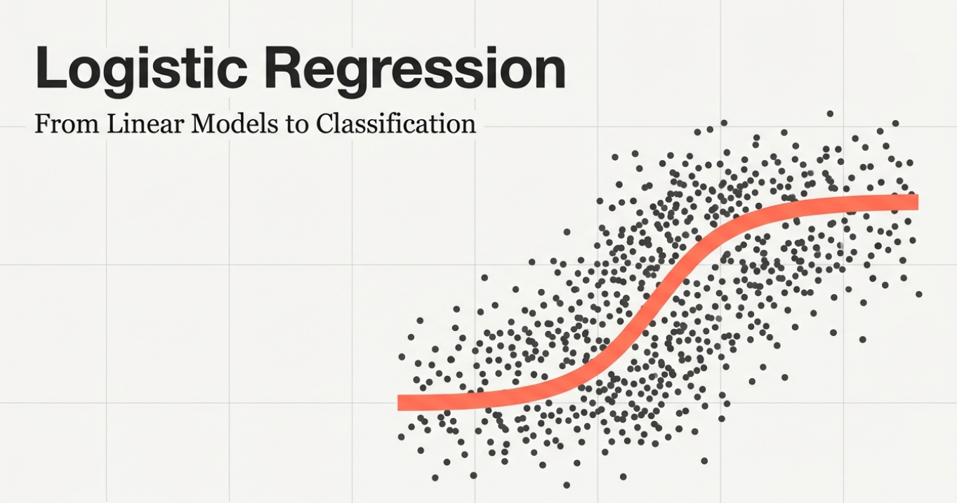

Slide 30
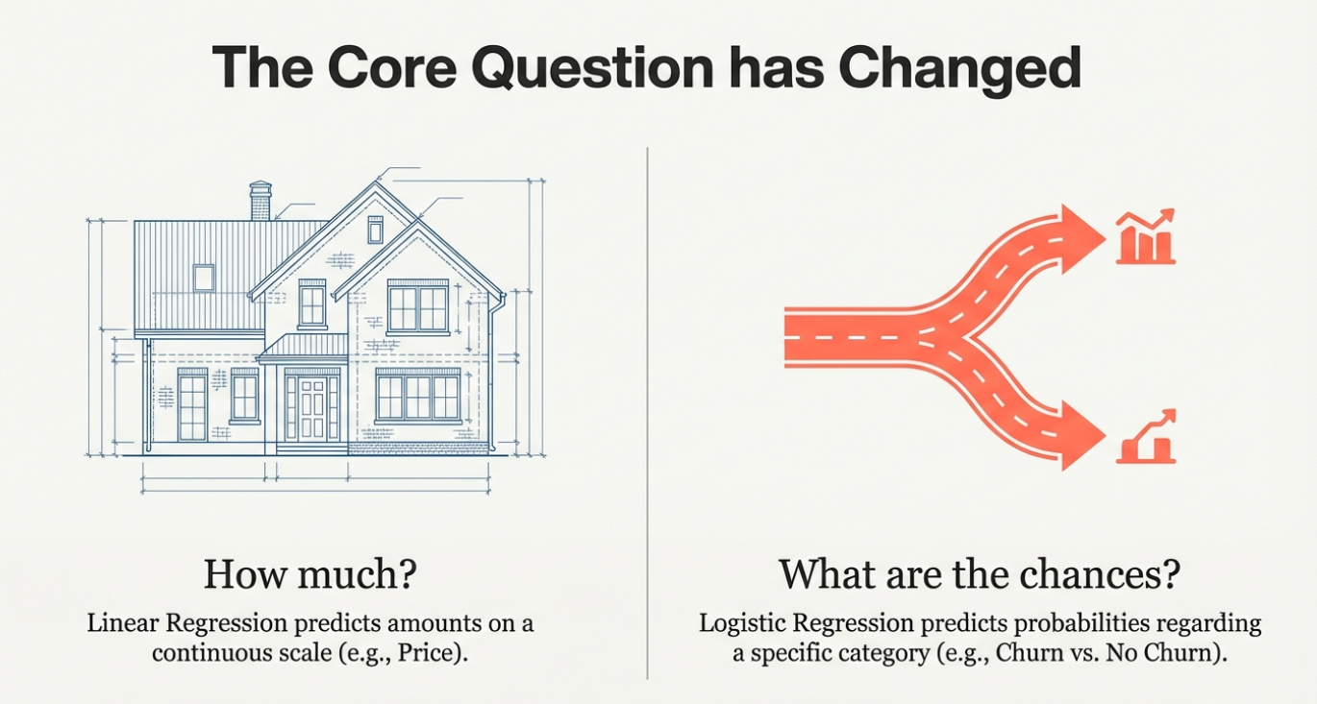

Slide 31

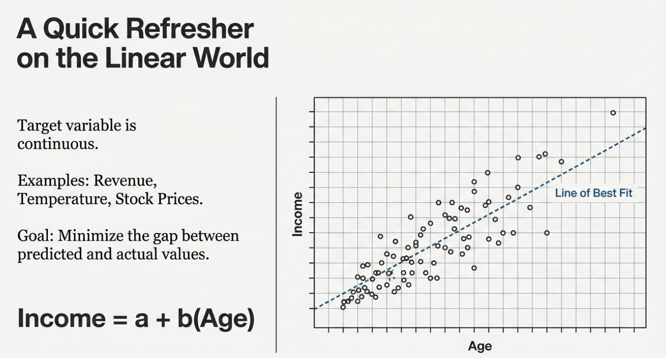

Slide 32
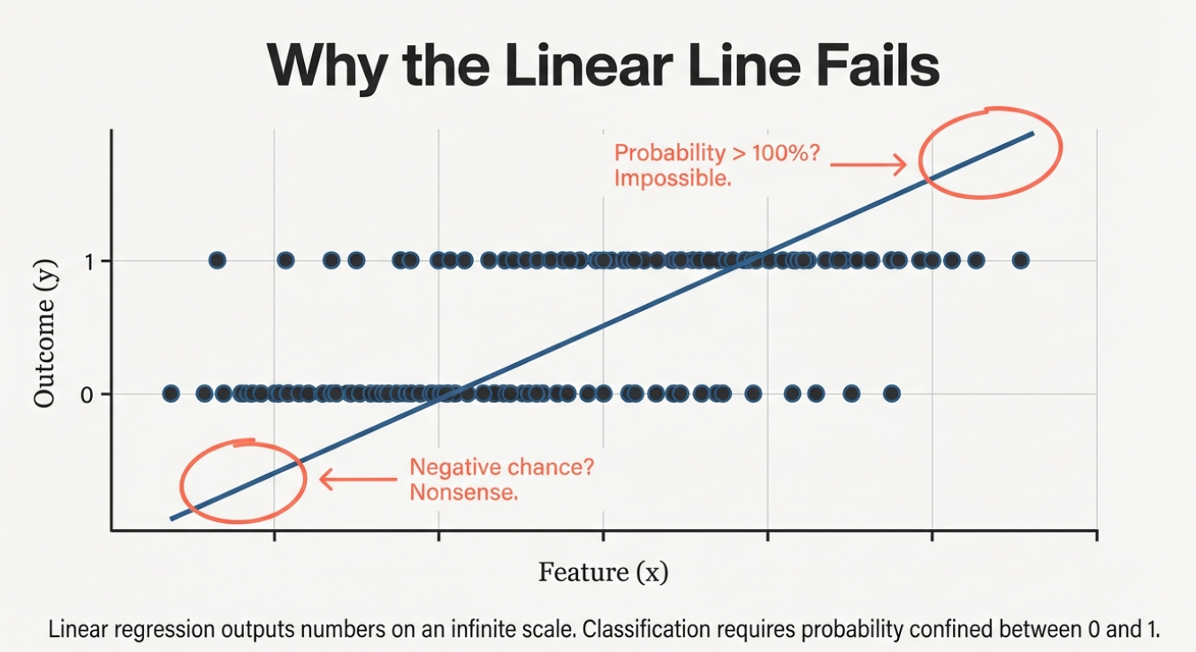

Slide 33

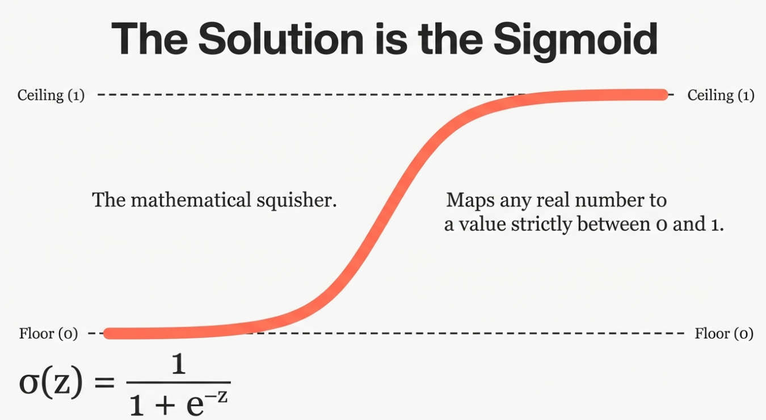

Slide 34
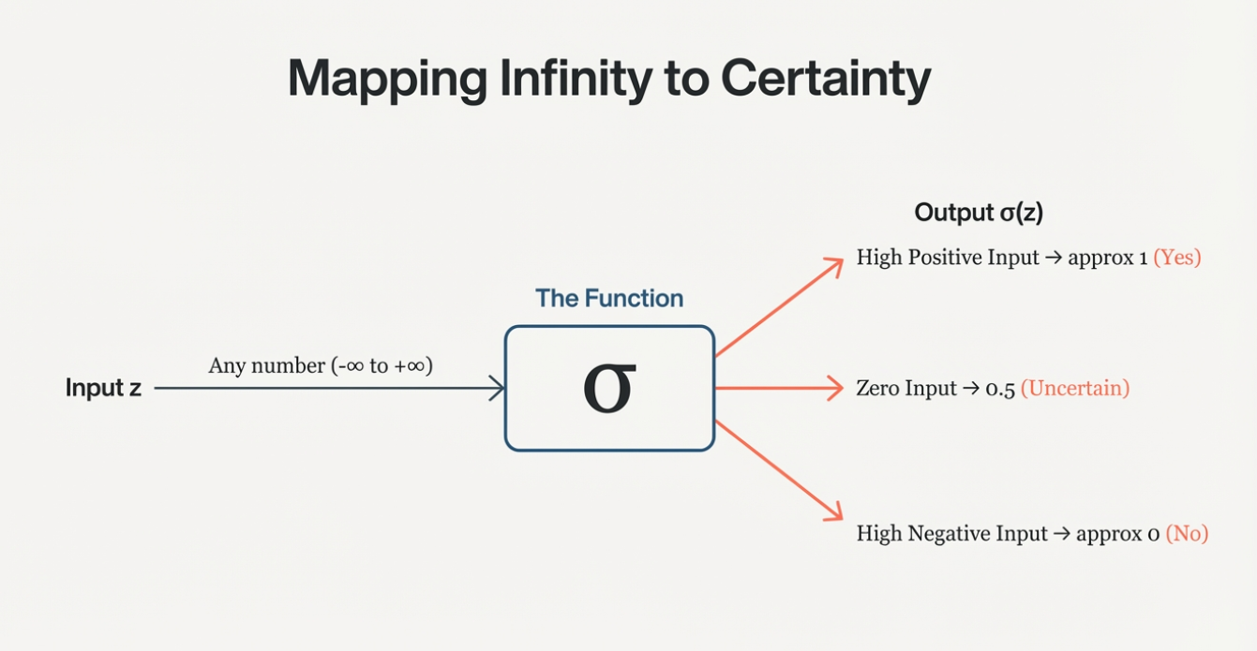

Slide 35
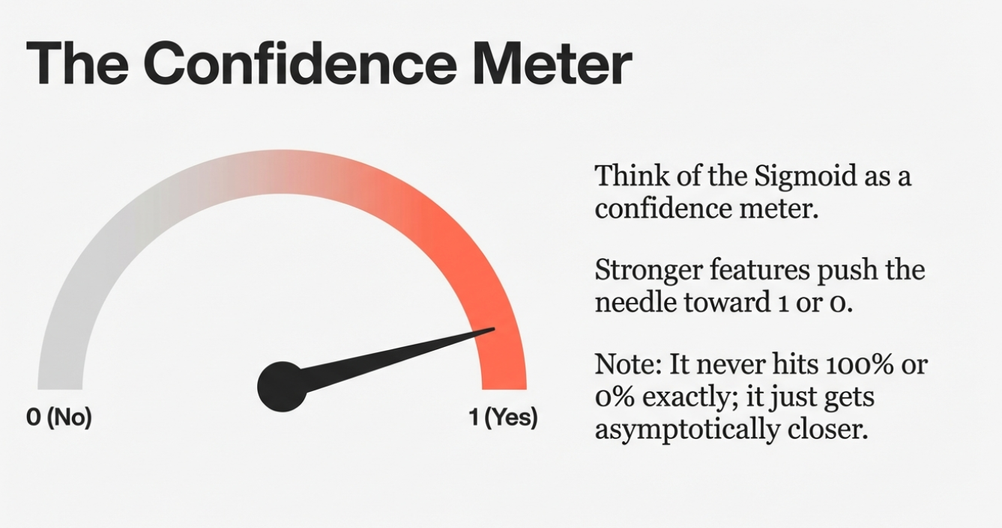

Slide 36
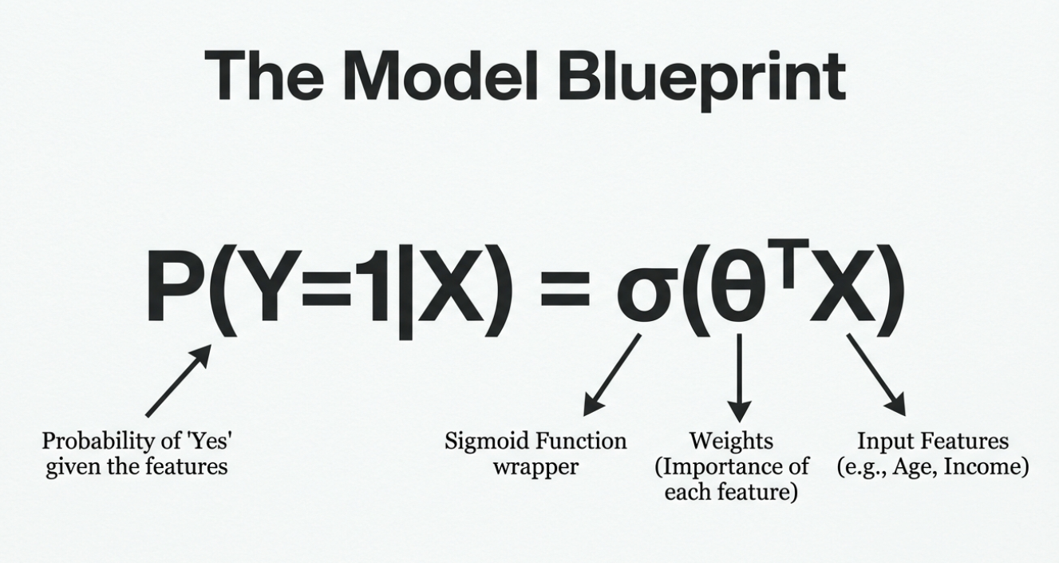

Slide 37
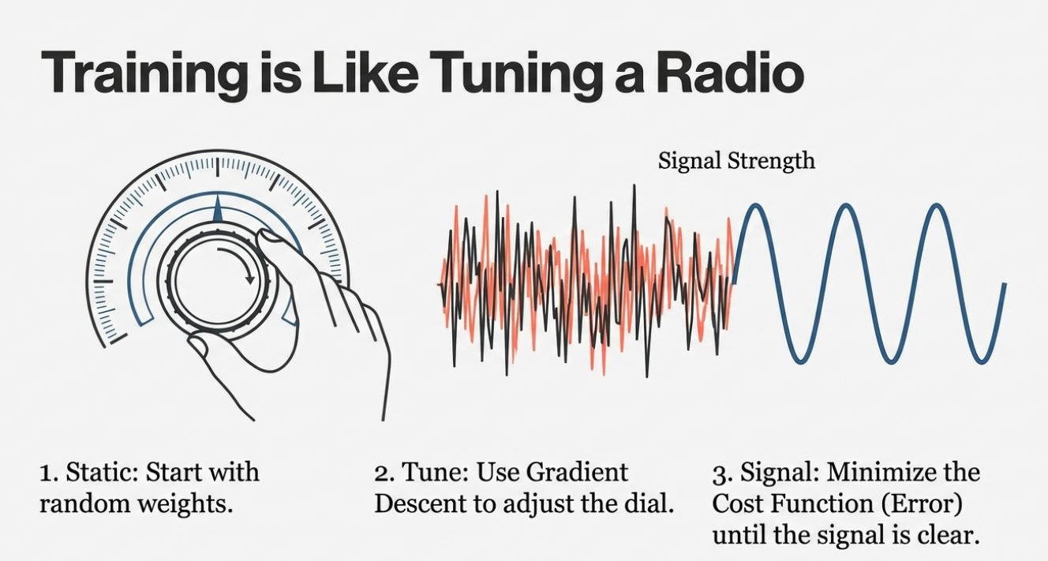

Slide 38
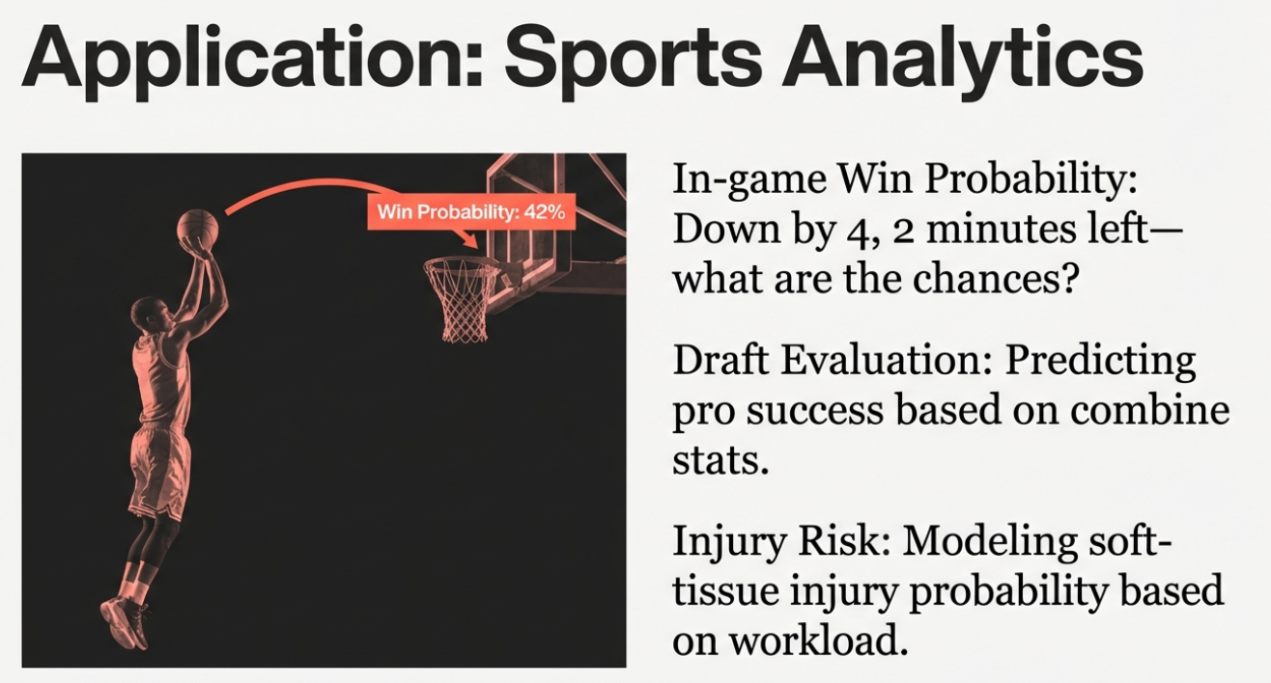

Slide 39
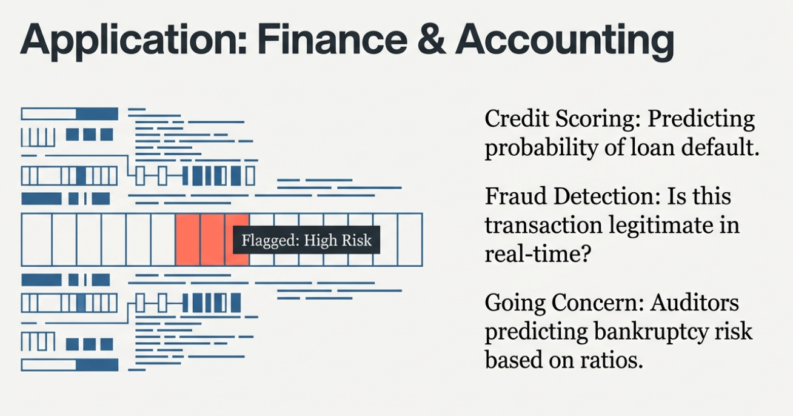

Slide 40
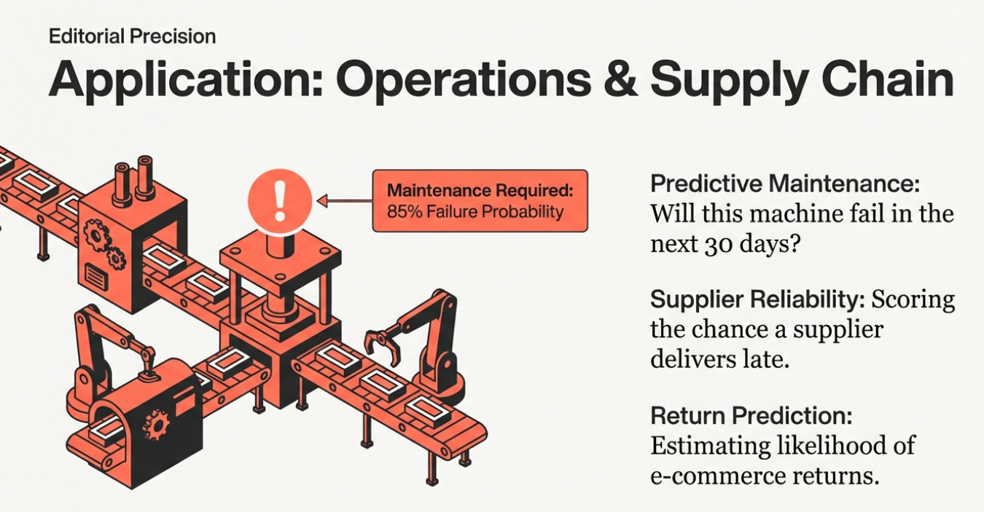

Slide 41
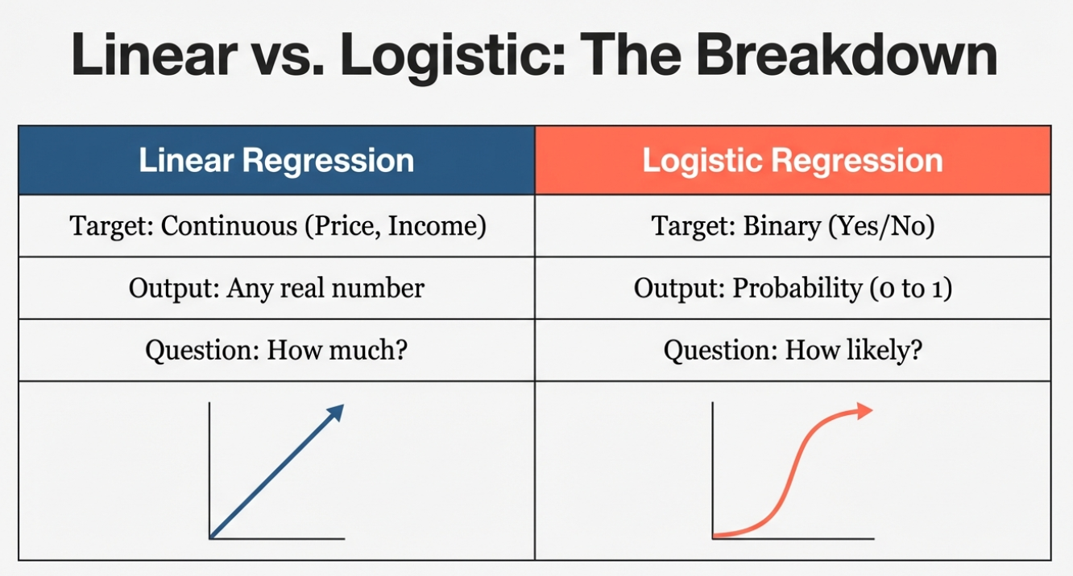

Slide 42
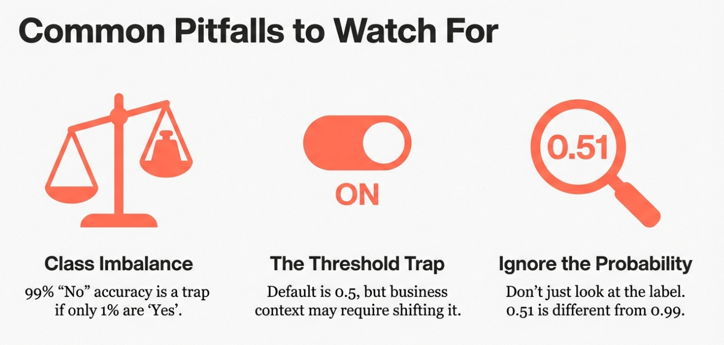

Slide 43


Slide 44
Part 3. Data Prepping

Slide 45
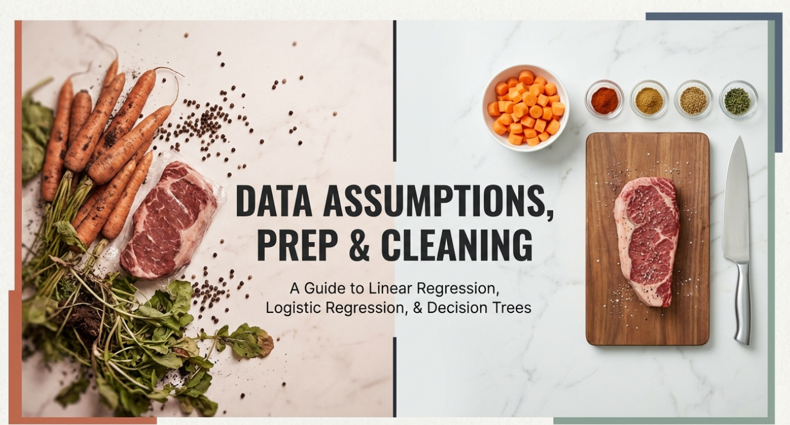

Slide 46
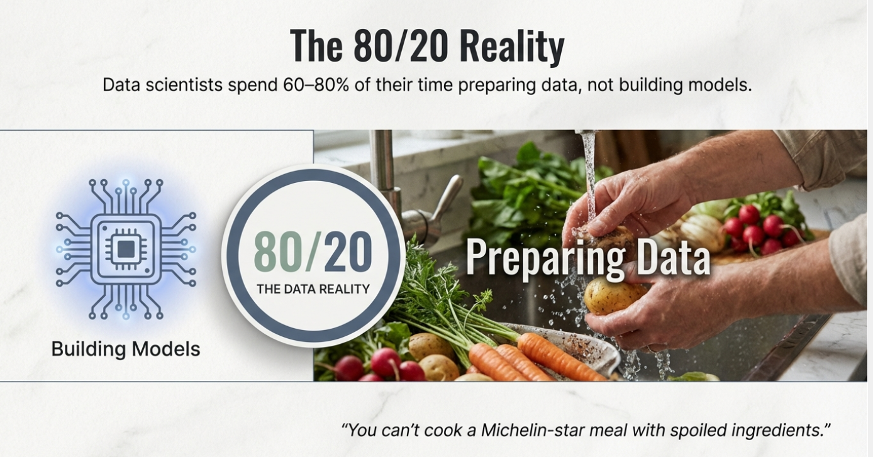

Slide 47
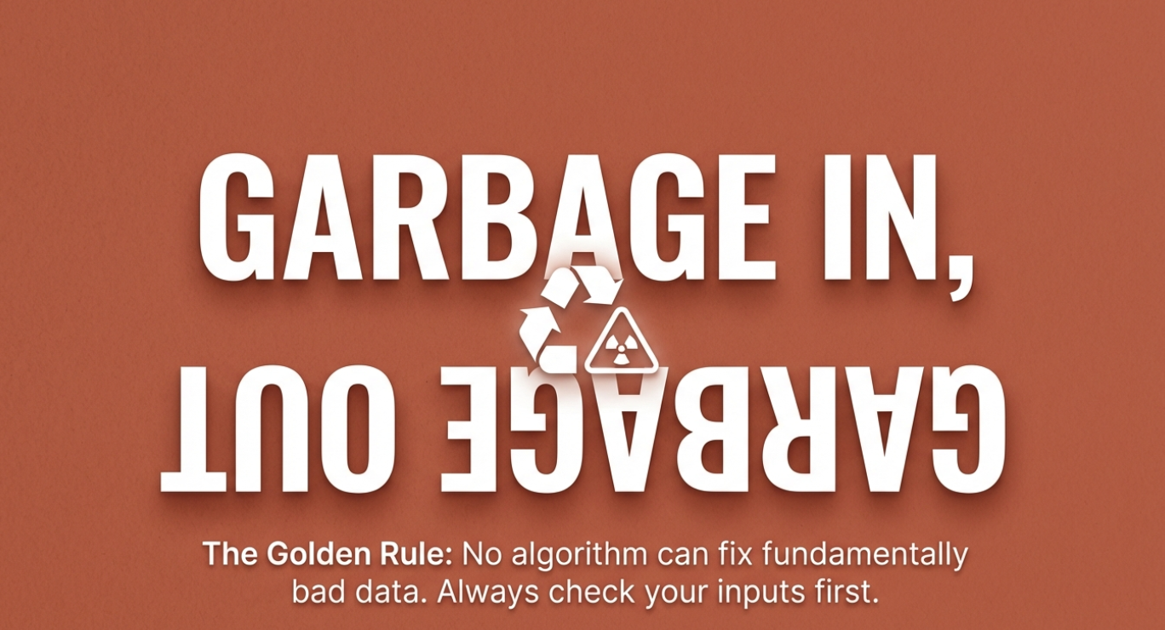

Slide 48
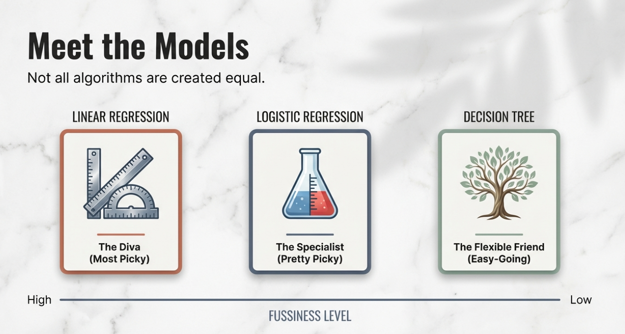

Slide 49
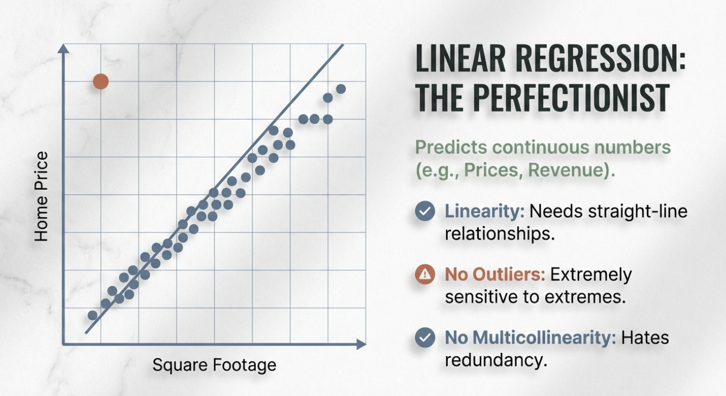

Slide 50
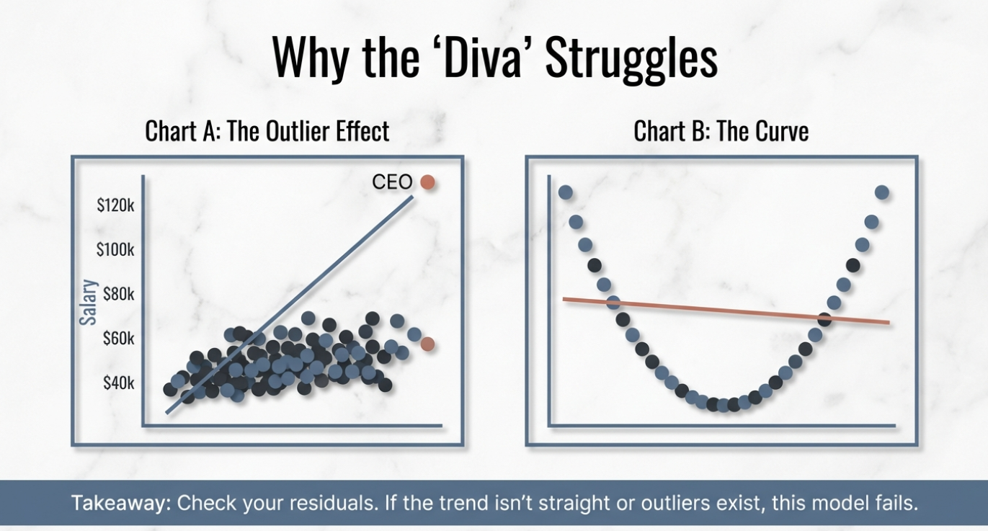

Slide 51
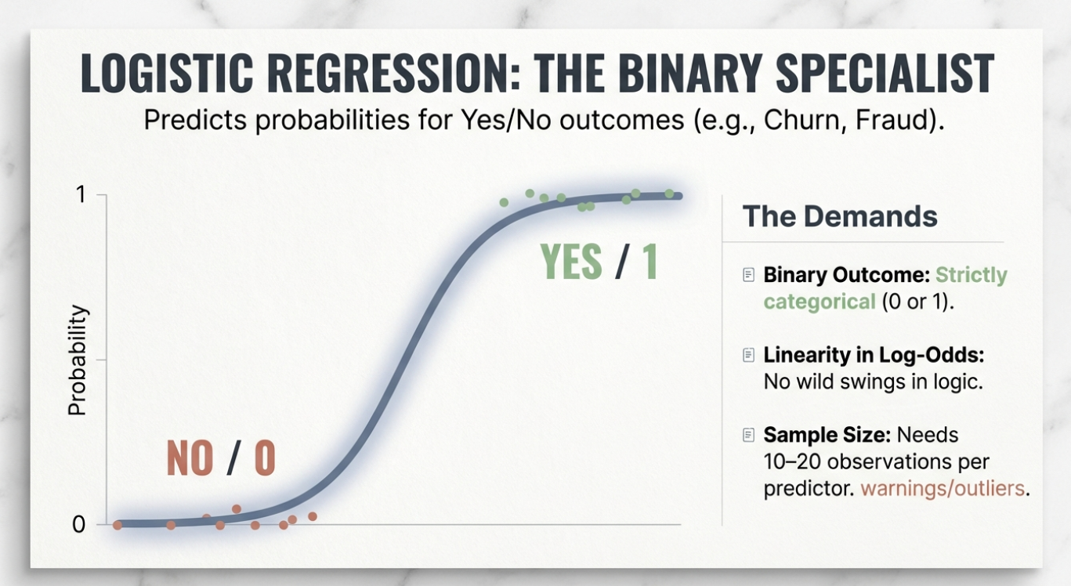

Slide 52
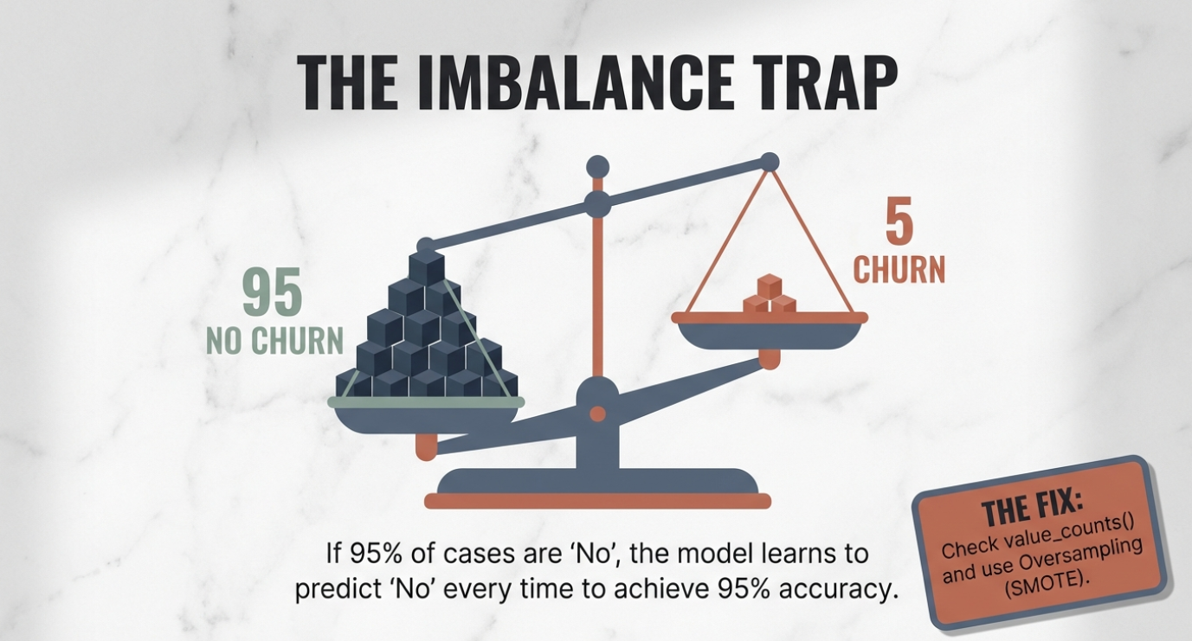

Slide 53
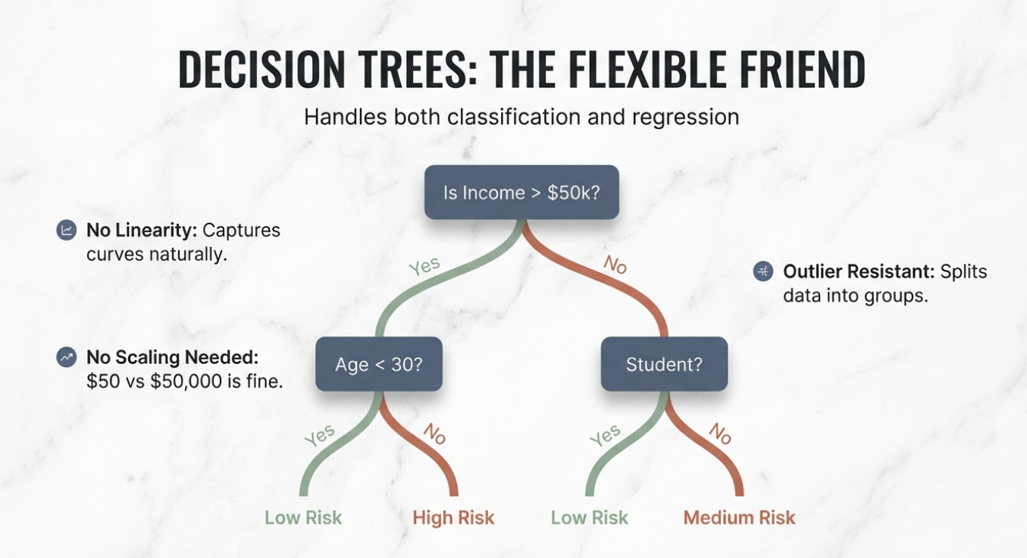

Slide 54
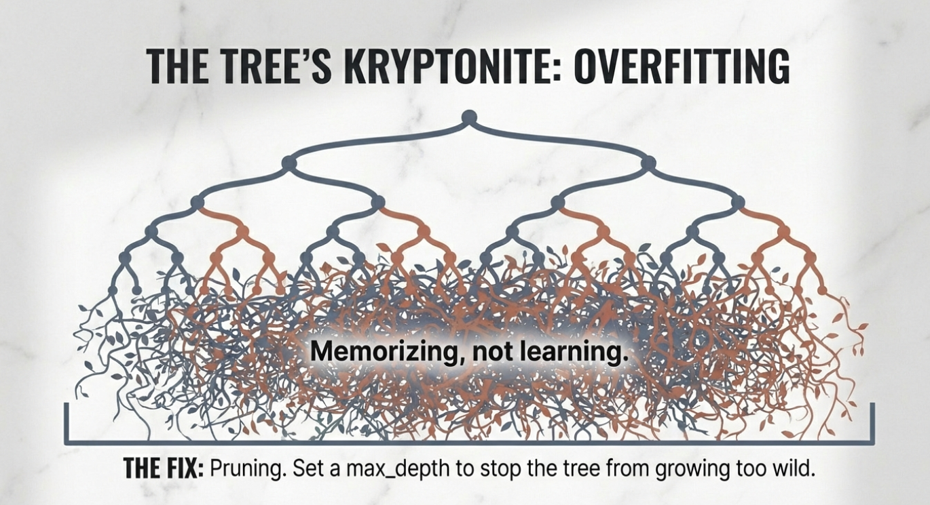

Slide 55
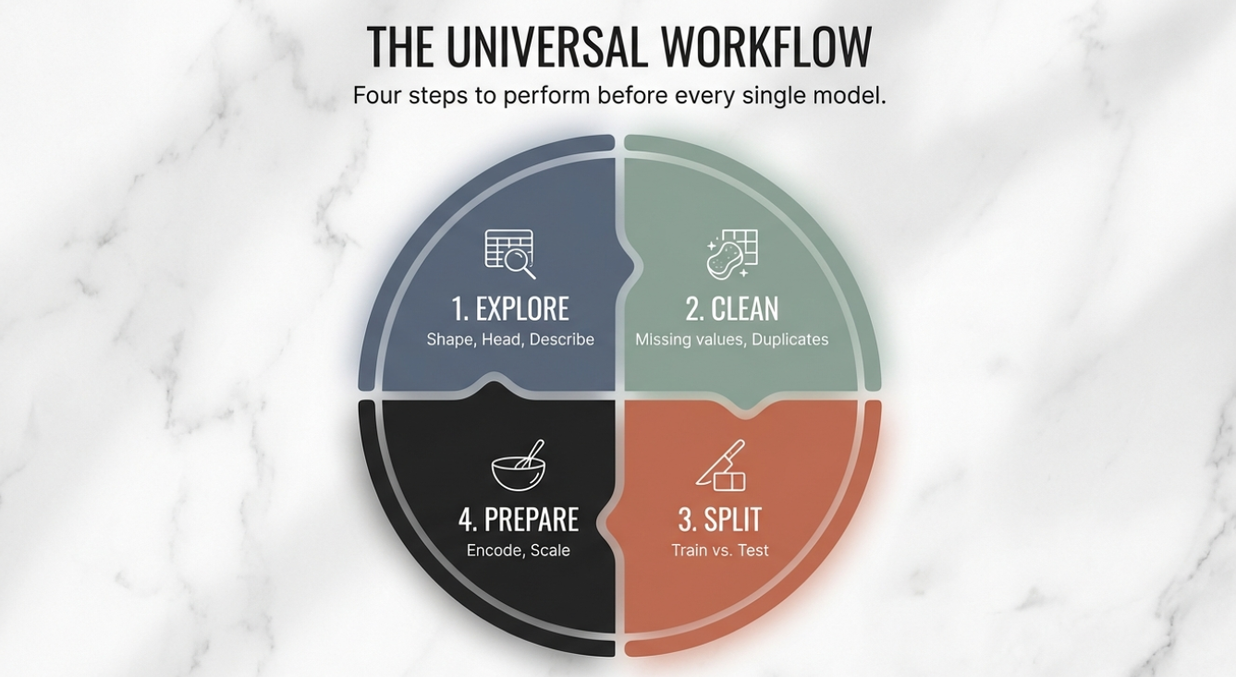

Slide 56
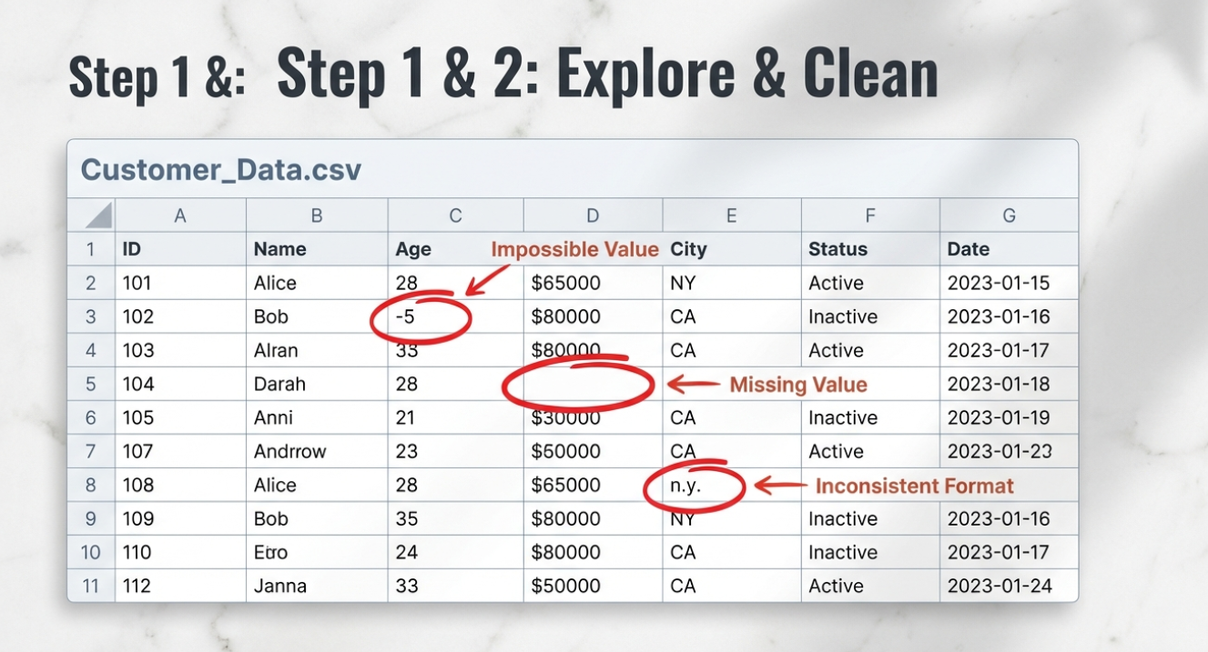

Slide 57

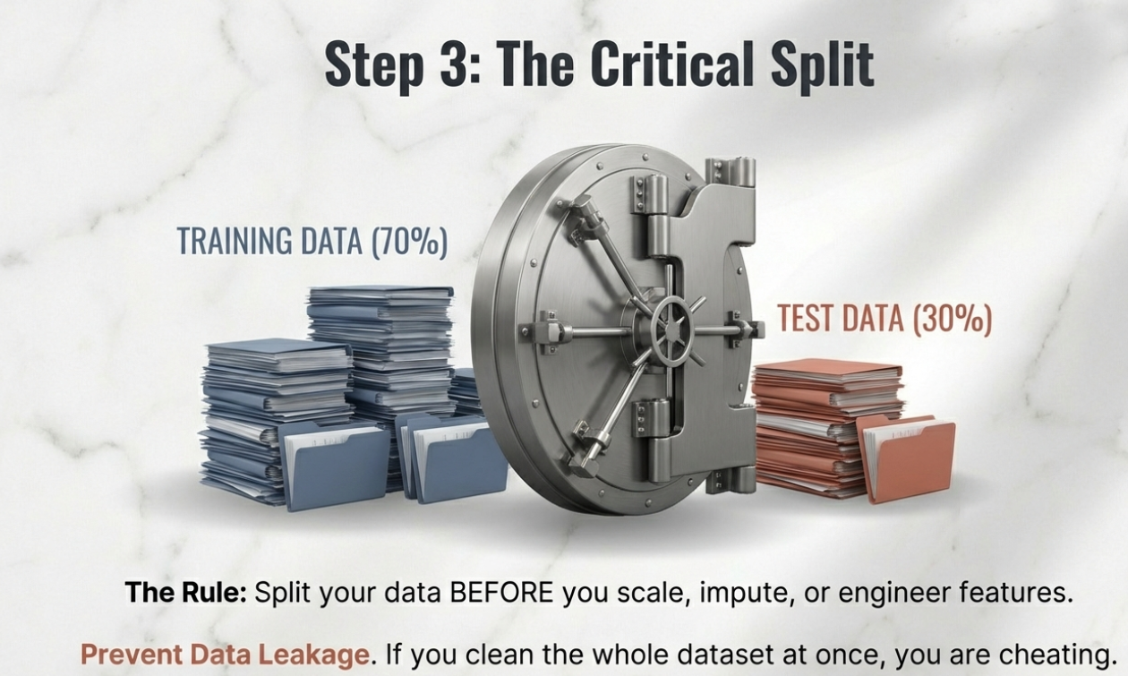

Slide 58
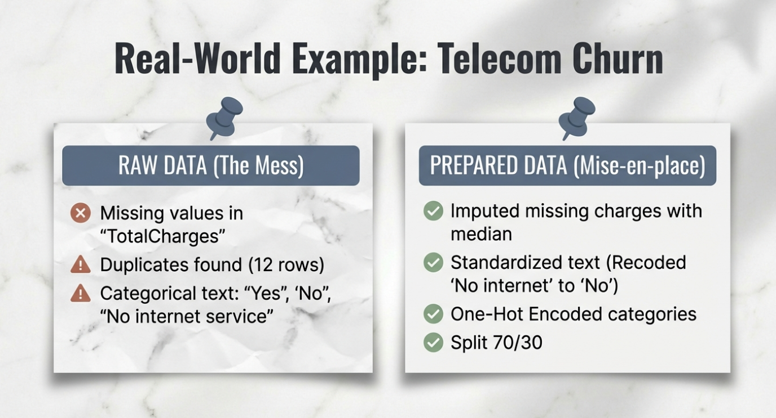

Slide 59
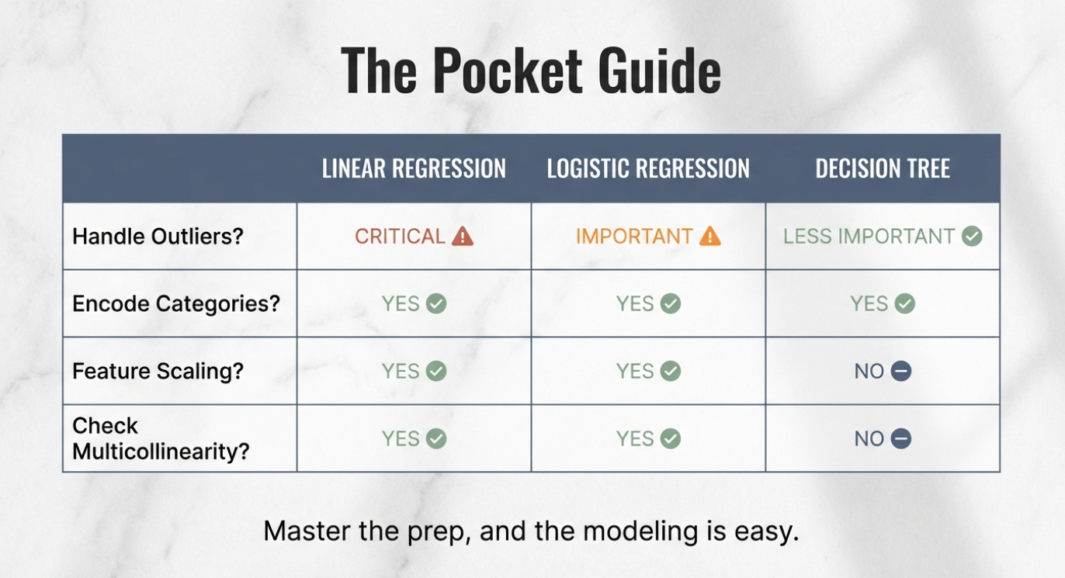

Slide 60
Part 4. Correlation & Causation
Why your domain expertise is crucial.

Slide 61
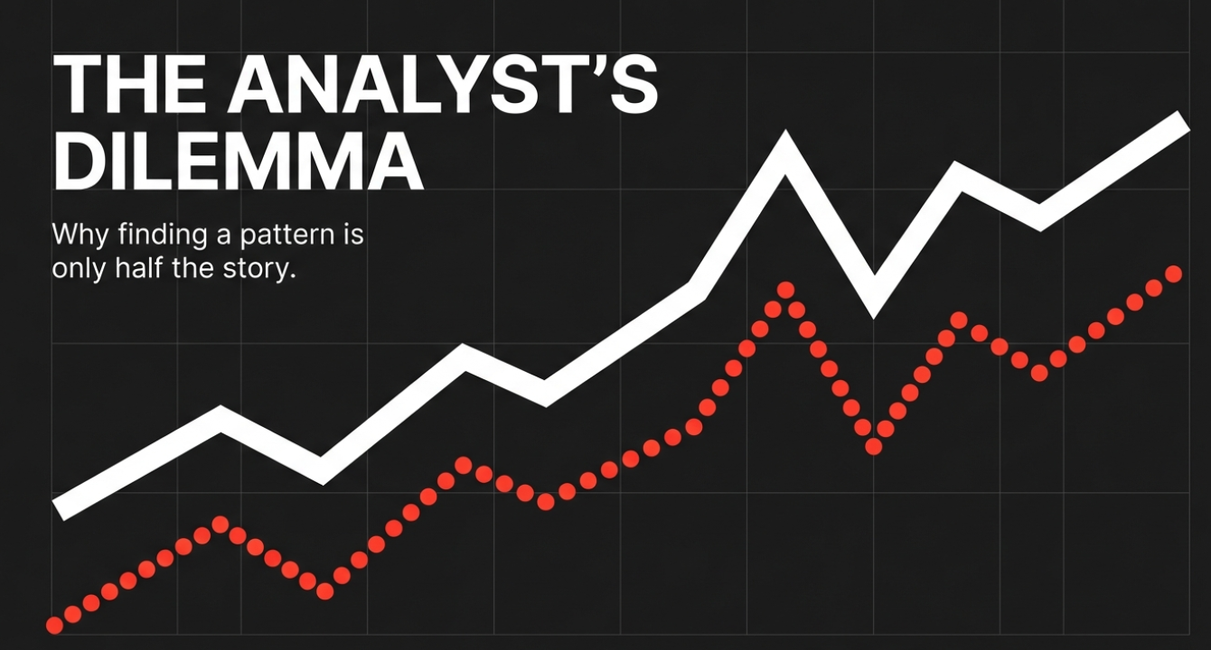

Slide 62


Slide 63
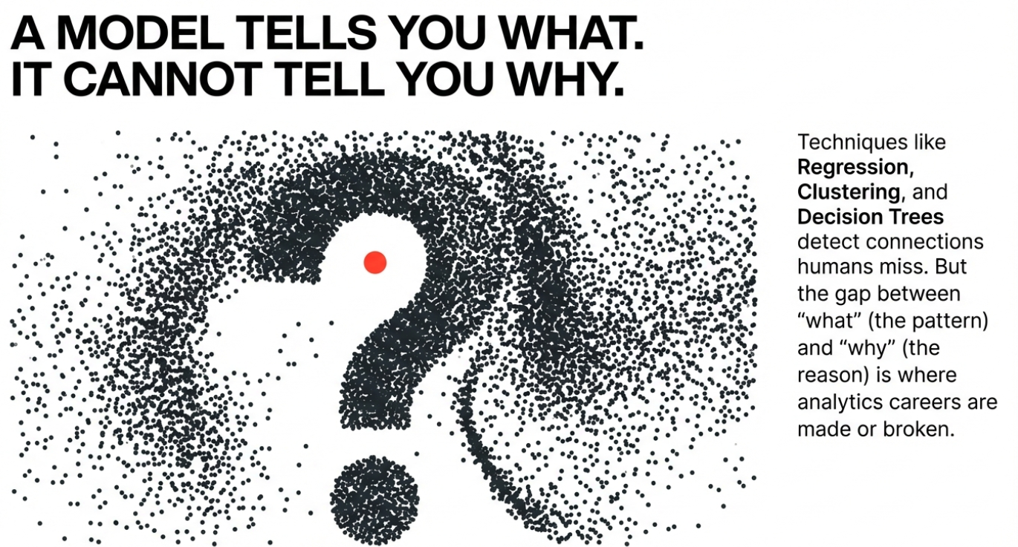

Slide 64
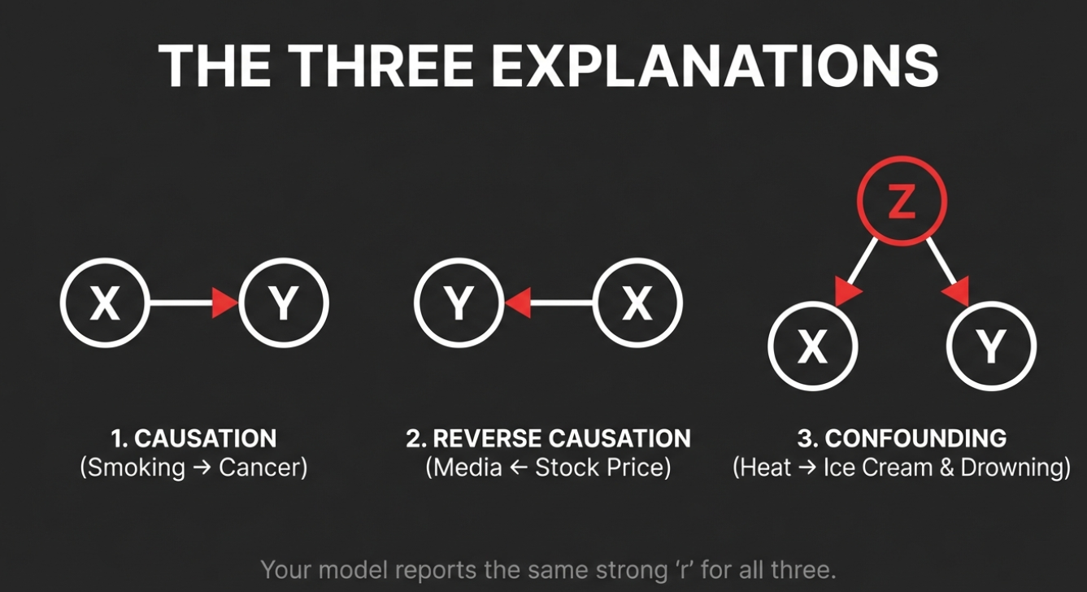

Slide 65


Slide 66


Slide 67


Slide 68


Slide 69


Slide 70


Slide 71


Slide 72



Slide 73


Slide 74


Slide 75


