Slide 1
How to use KathyJane package?
Check out these to see how I built this package:

Slide 2
Assumptions
You have these:
Hosting service & domain name (usually come with a hosting service subscription)
GenAI coding assistant – ChatGPT, Claude, or Gemini (I use them all, plus desktop app like Claude Cowork and ChatGPT Codex for Windows)
Note: for this demo, I used mainly Claude Opus 4.6 for coding and ChatGPT (Auto) for creating images

Slide 4

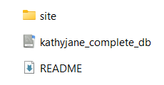
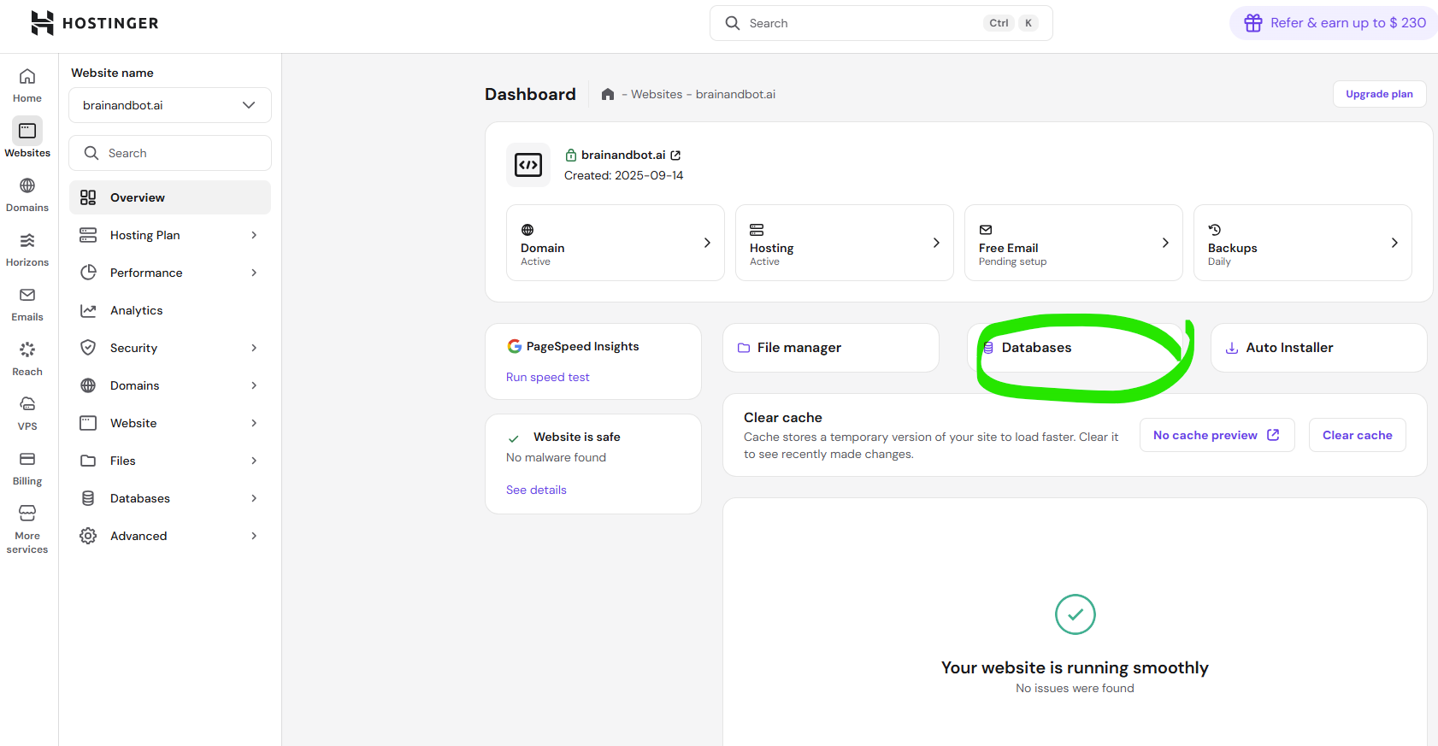

Slide 5
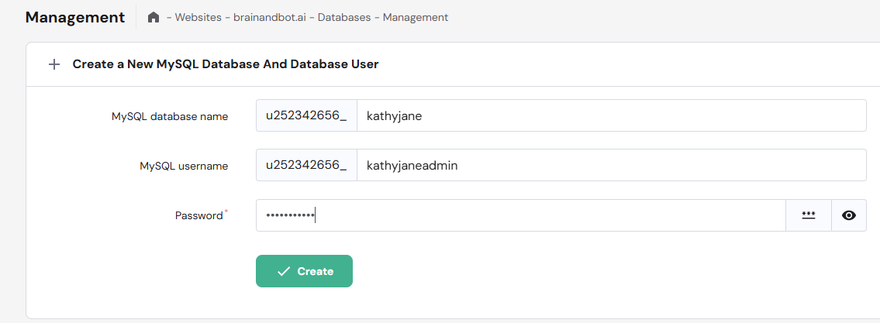
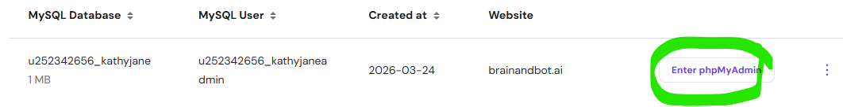
Your can name your database differently.

Slide 6
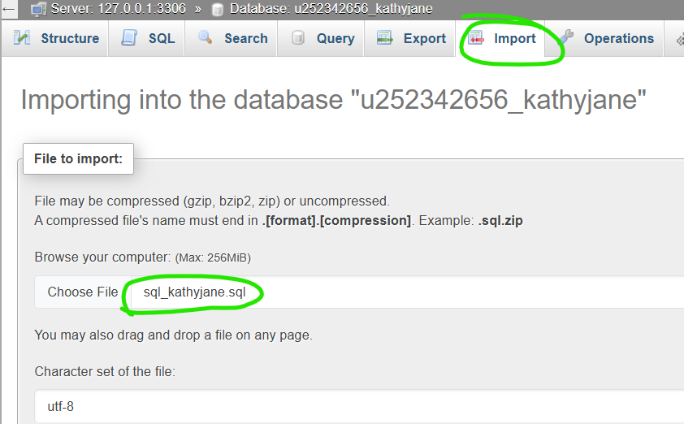
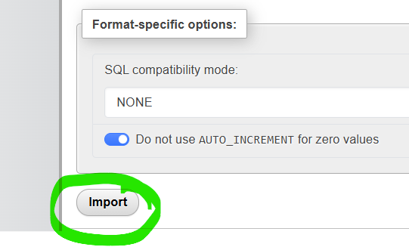

Slide 7
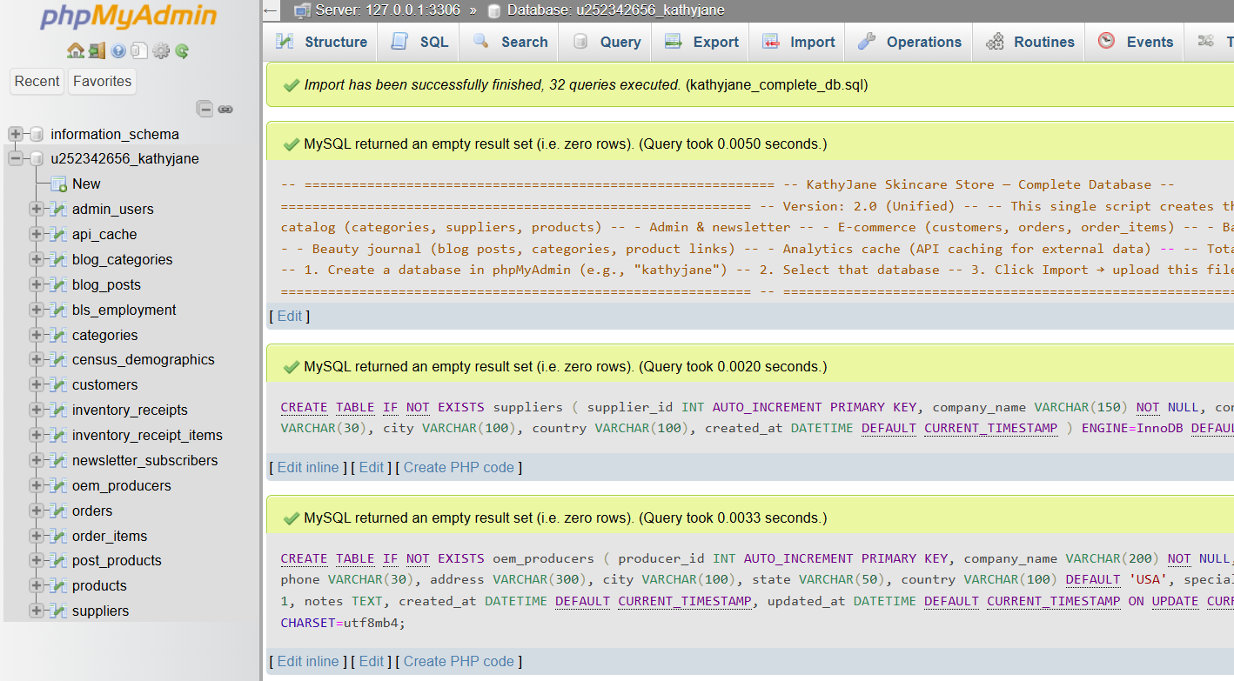

Slide 8
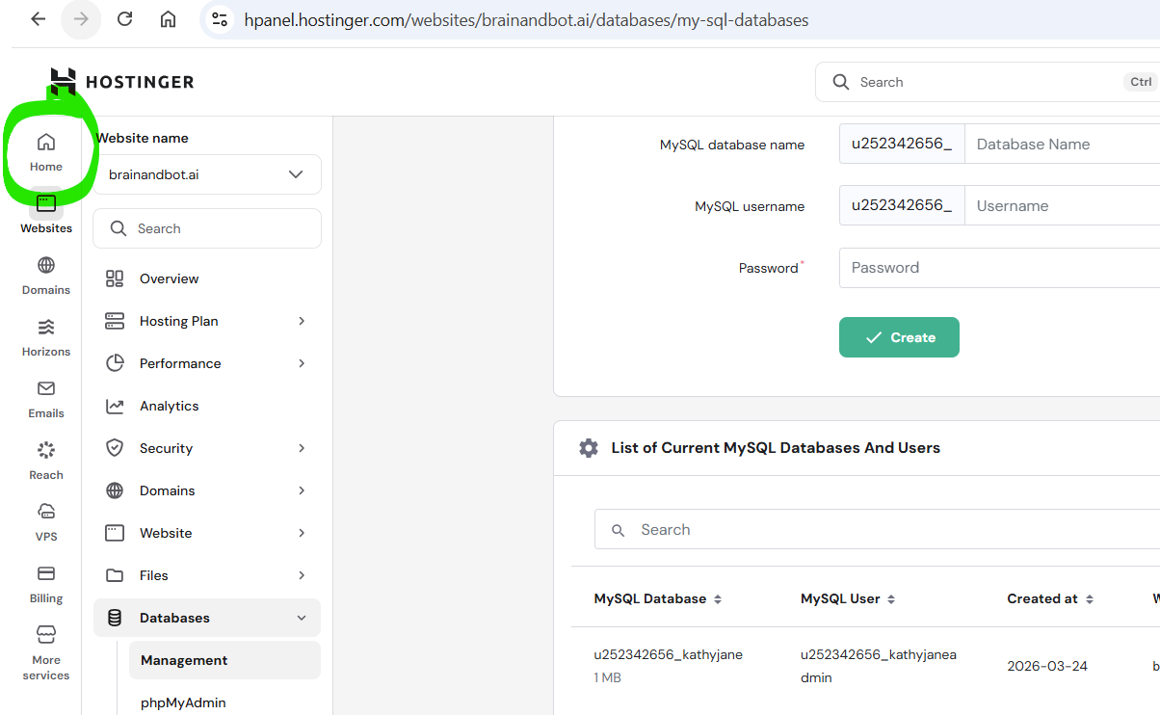
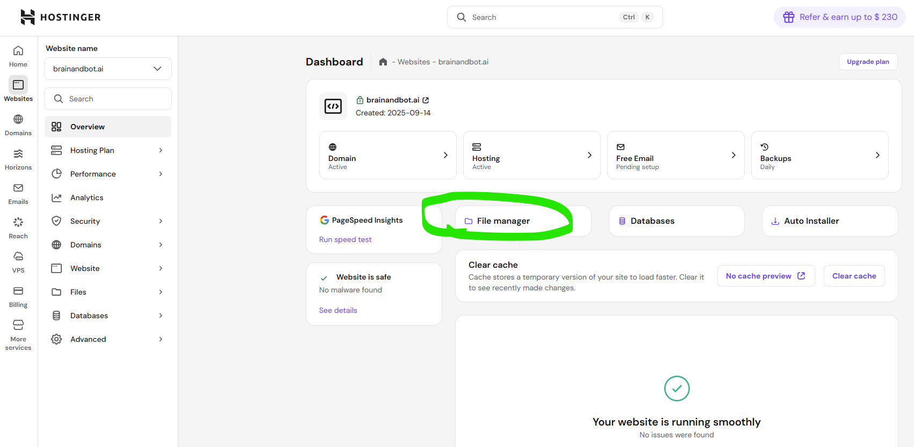

Slide 9
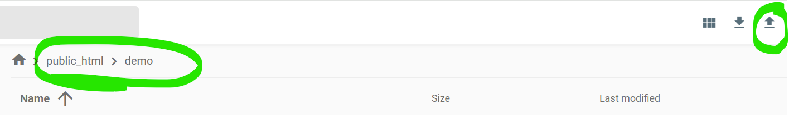
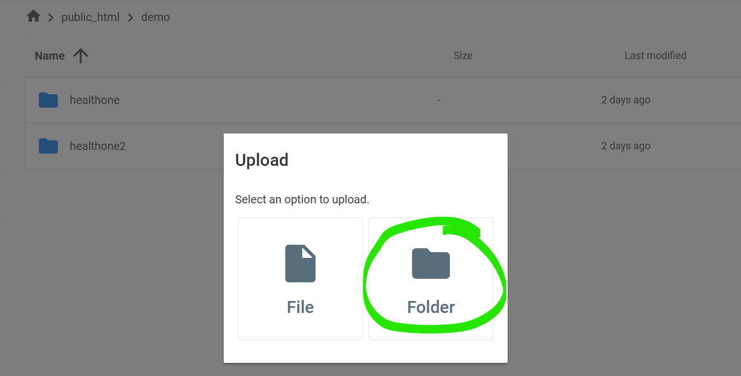
Unzip kathyjane zipped folder and upload it to your web server, inside demo

Slide 10

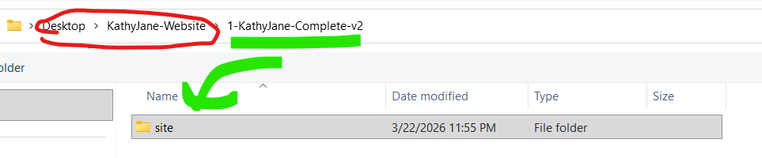
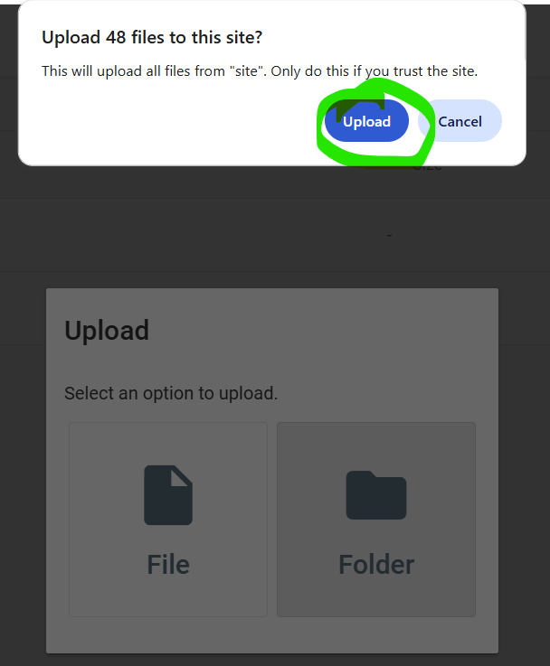


Slide 11
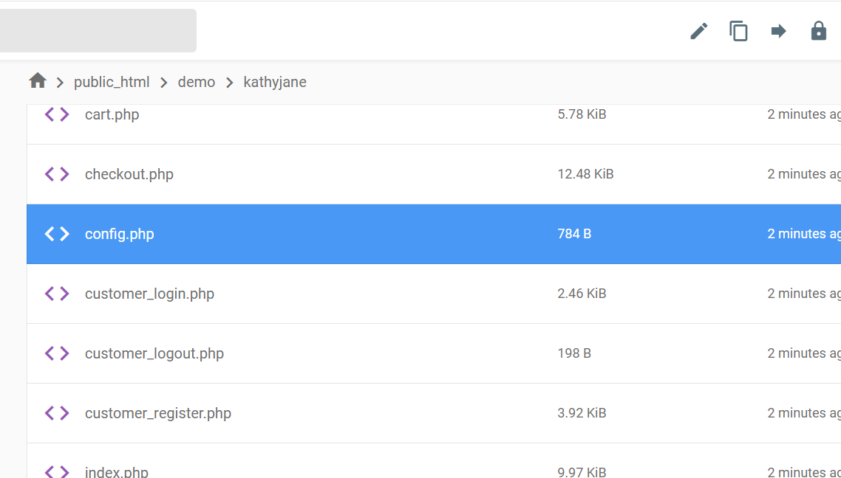
Double click config.php and change database info

Slide 12
