Slide 1
https://aiven.io/free-postgresql-database

Slide 2
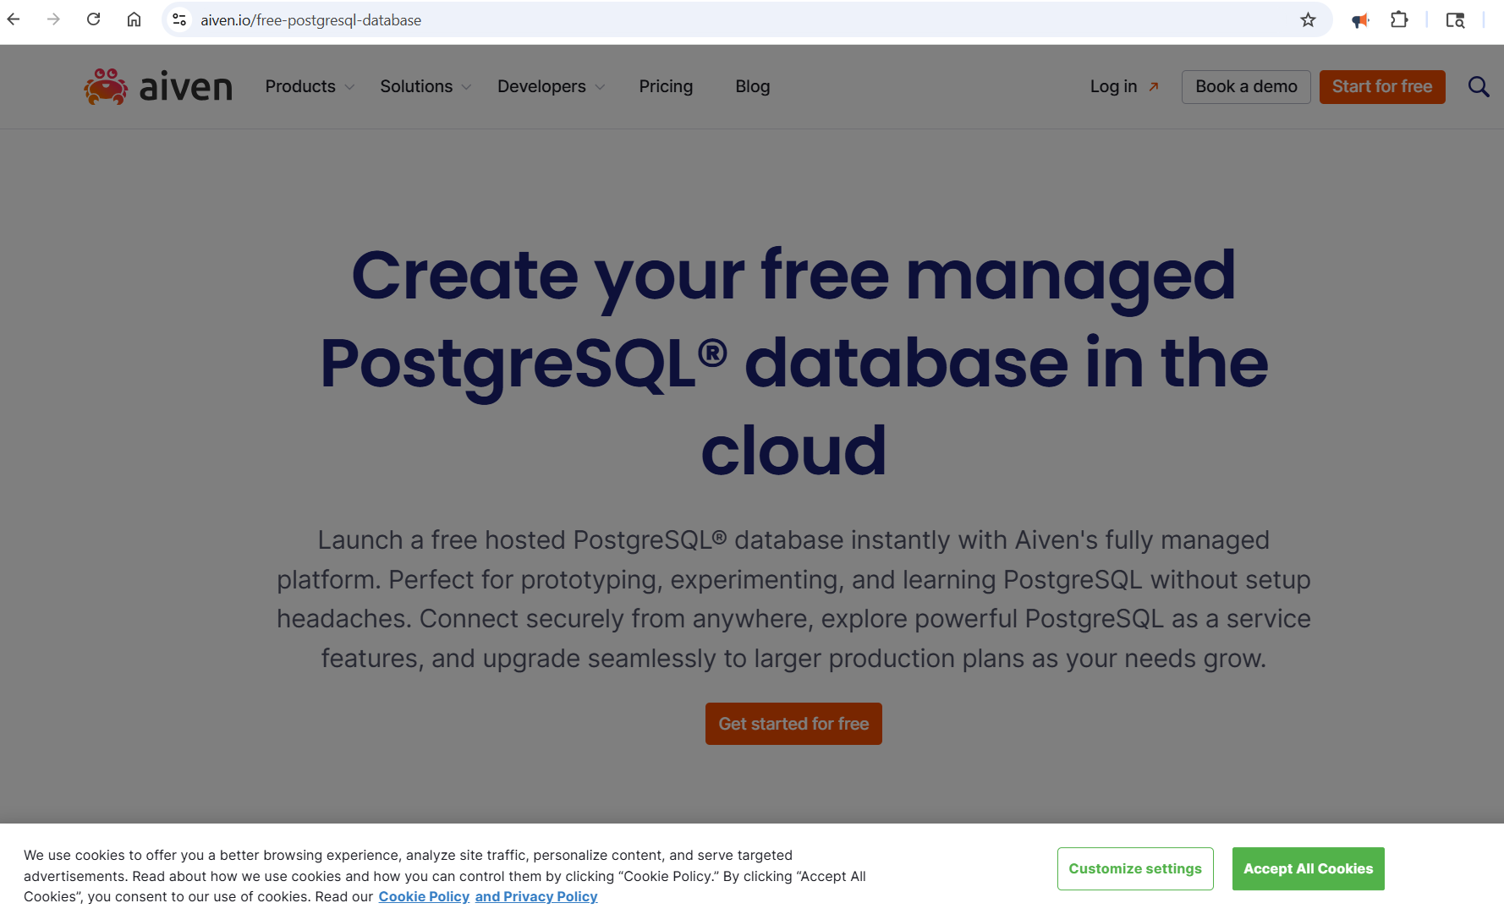

Slide 3
