Slide 1
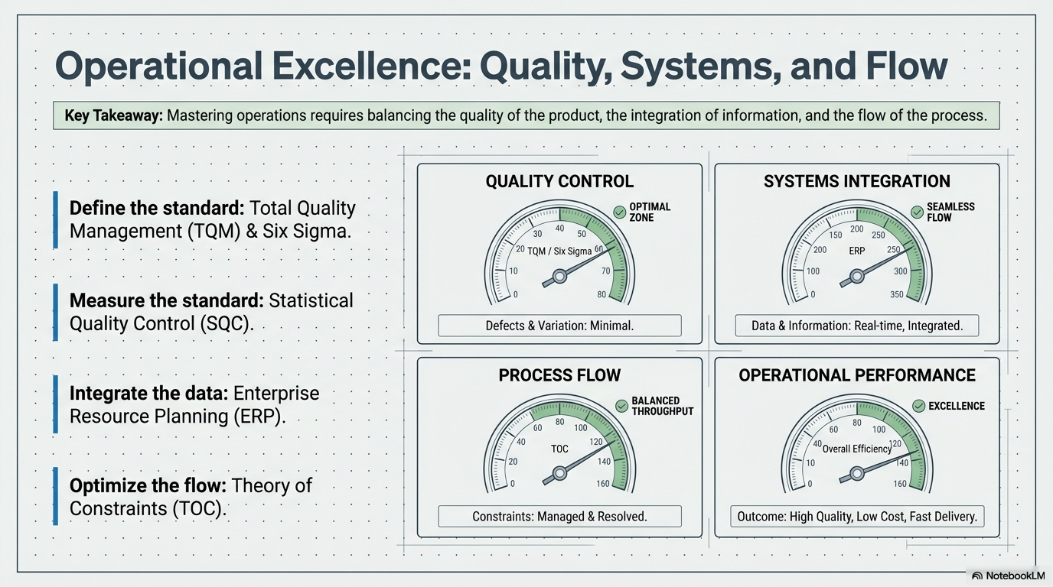

Slide 2
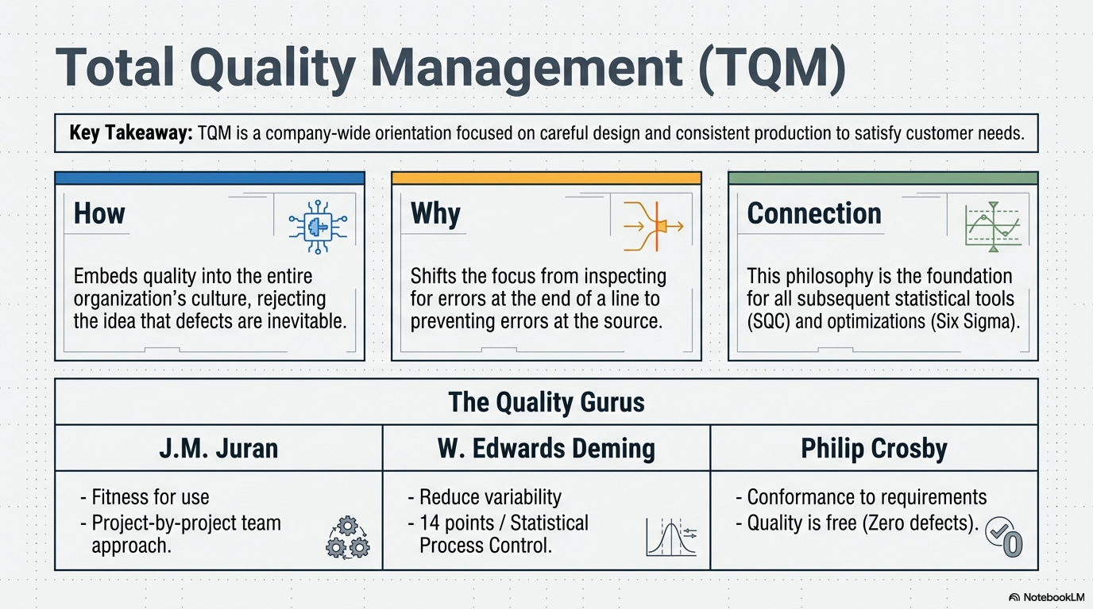

Slide 3
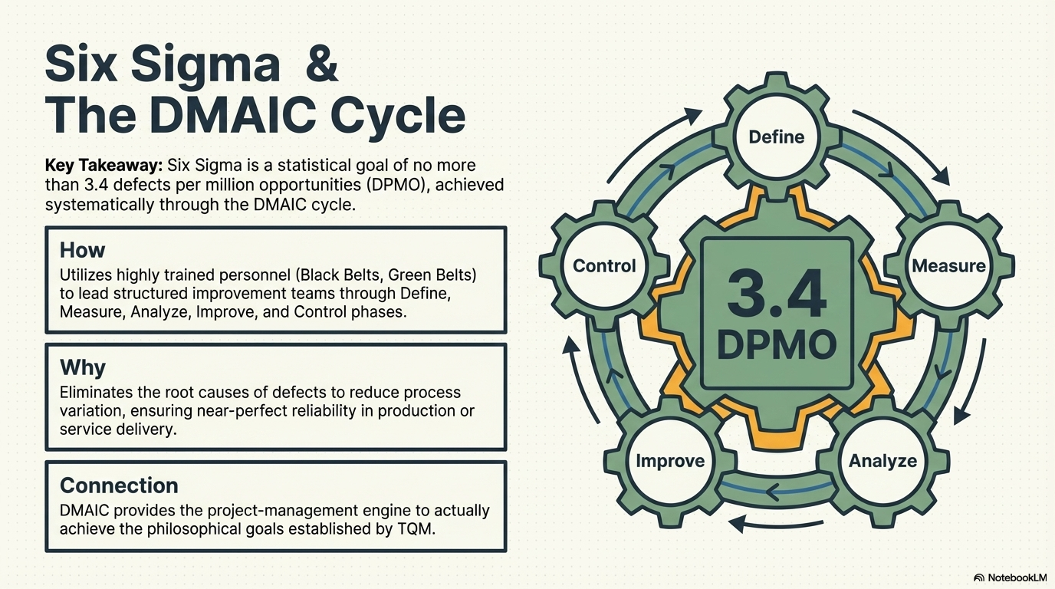

Slide 4
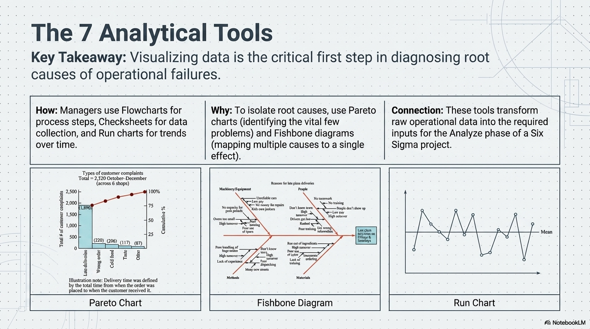

Slide 5
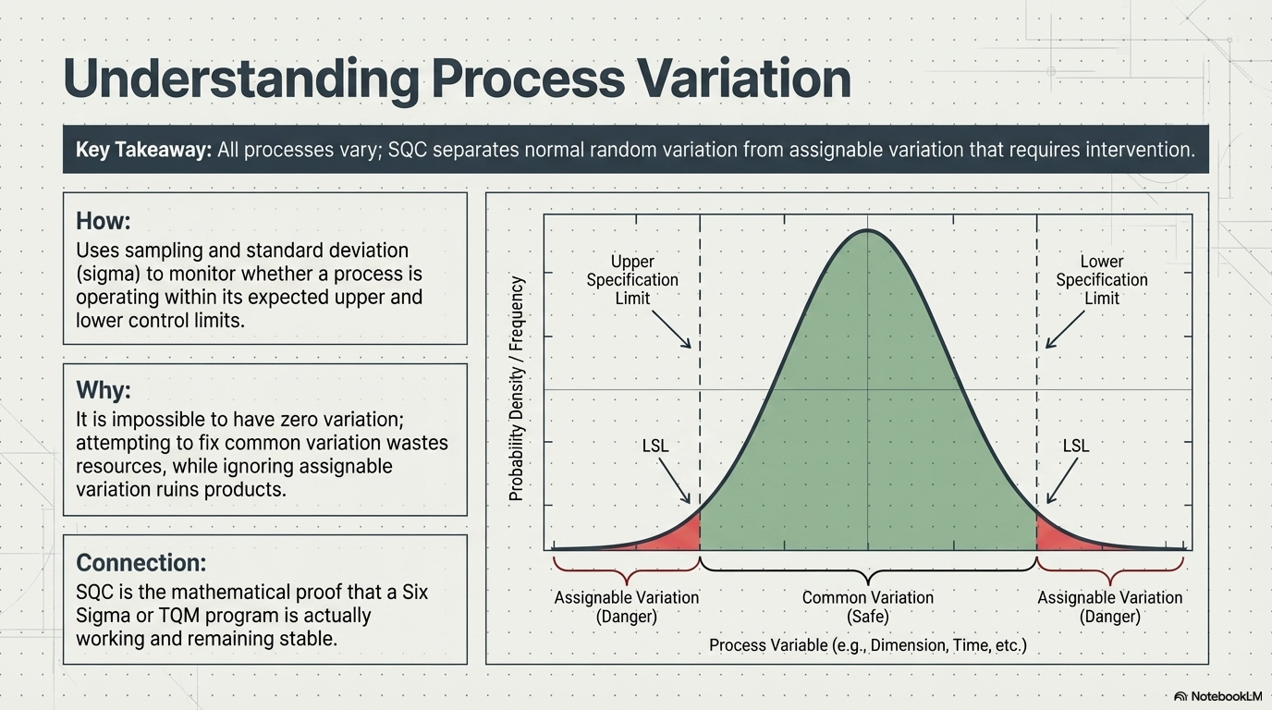

Slide 6
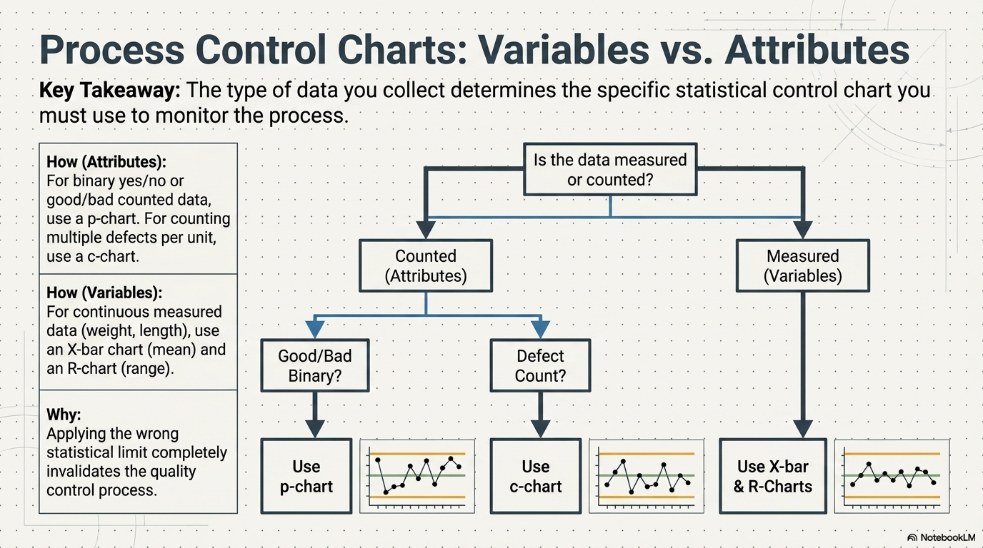

Slide 7
Statistical Process Control (SPC)
In control?
Process Capability (Cpk) meet specification?
Cpk = 1 -> 3 sigma quality https://www.6sigma.us/process-improvement/process-capability-index-cpk/

Slide 8

Customers want
In-control, but not what customers want

Slide 9

In-control, but slightly off from what customers want

Slide 10

In-control & meet customers’ specification

Slide 11

Out-of-control & doesn’t meet customers’ specification

Slide 12
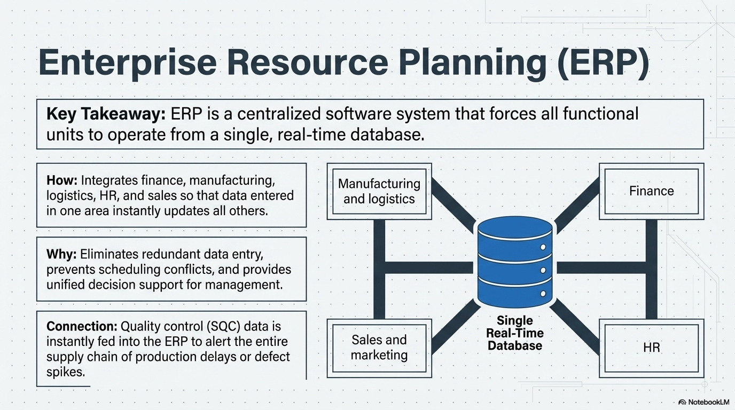

Slide 13
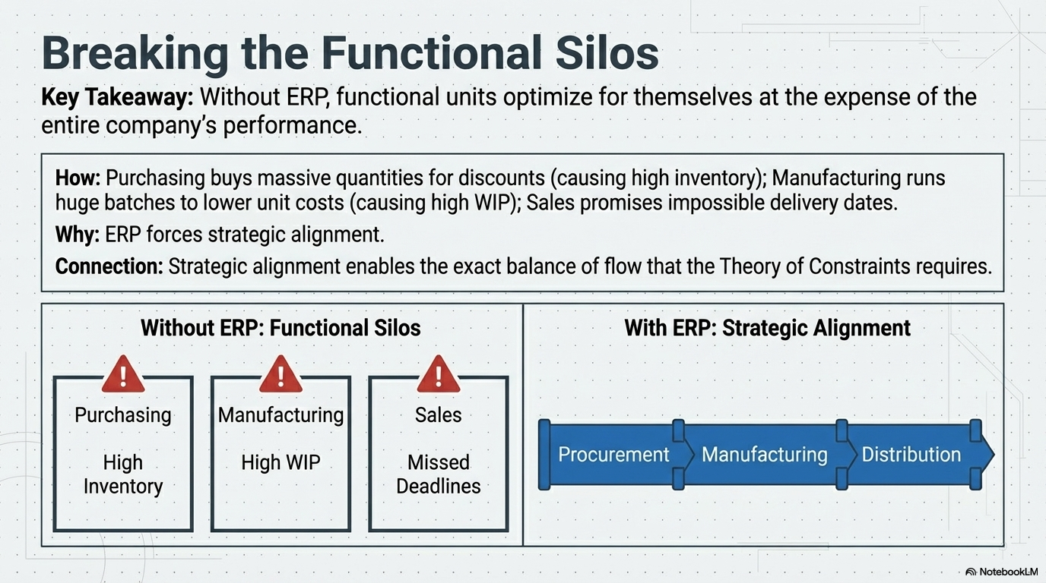

Slide 14
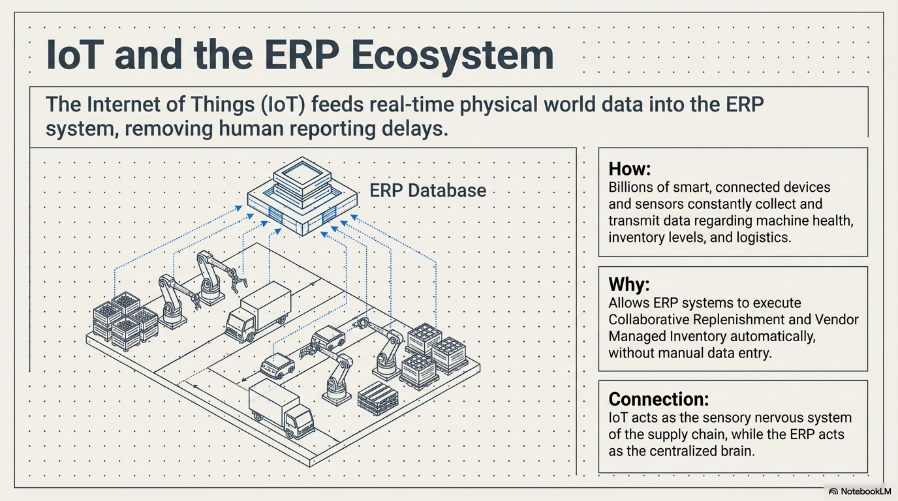

Slide 15
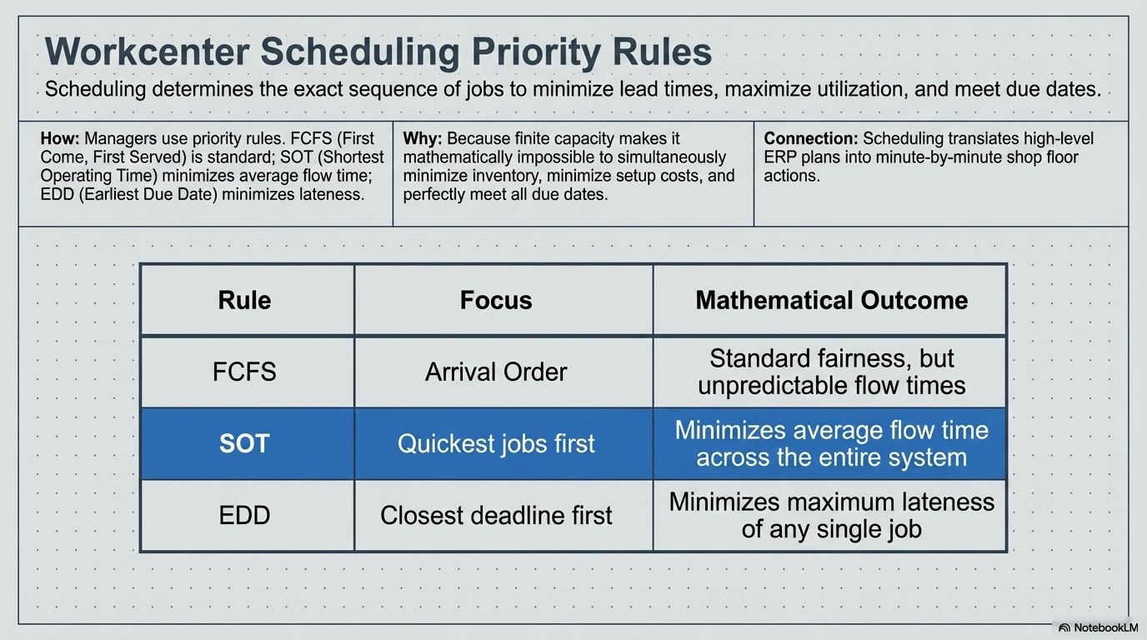

Slide 16
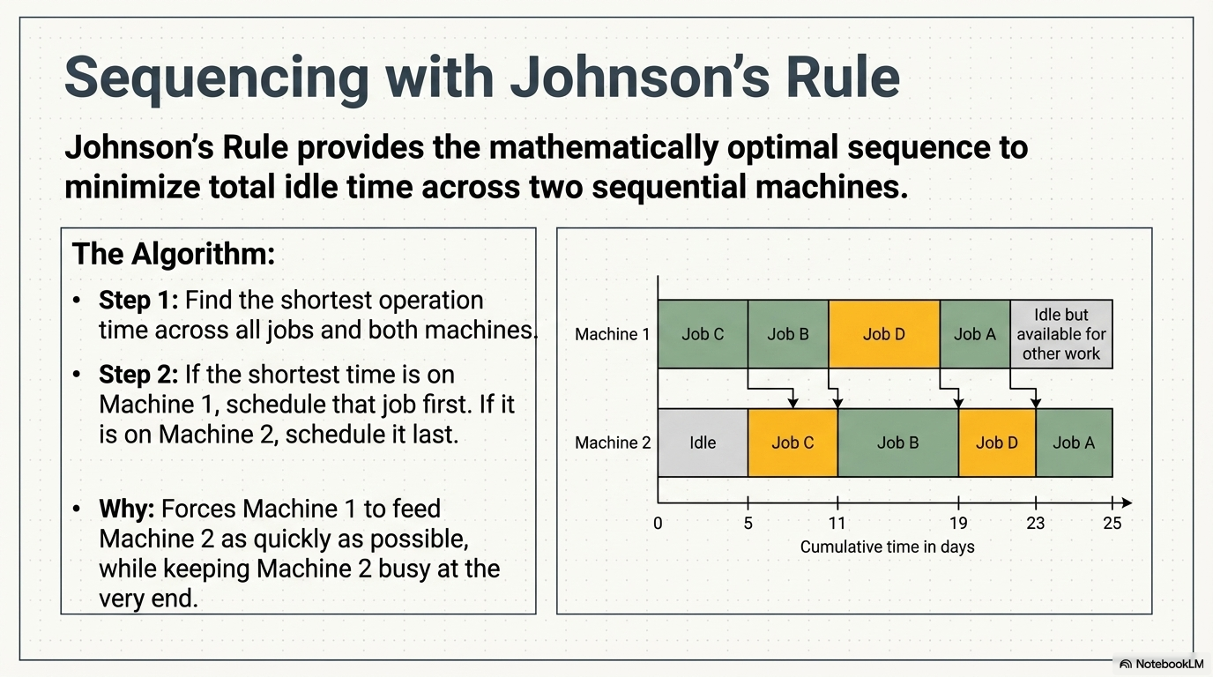

Slide 17
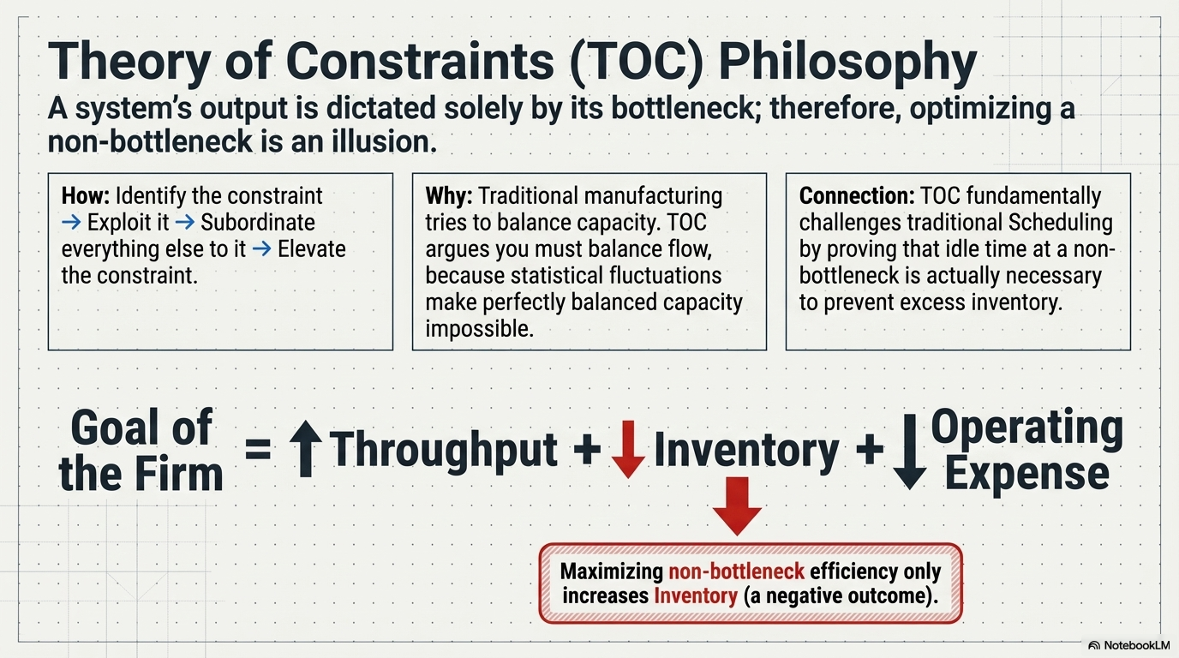

Slide 18
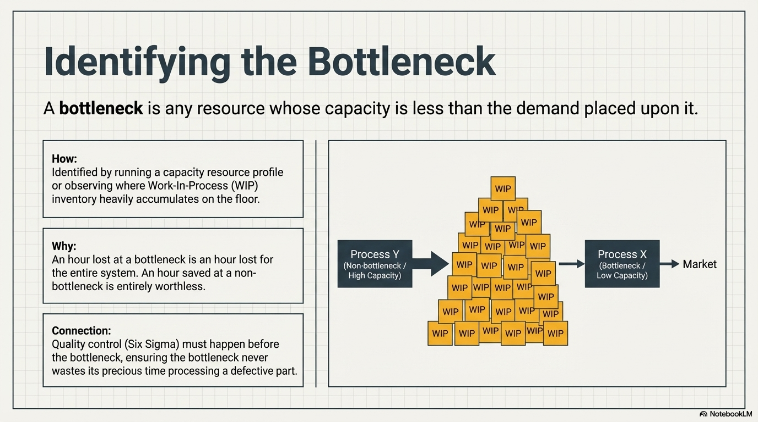

Slide 19
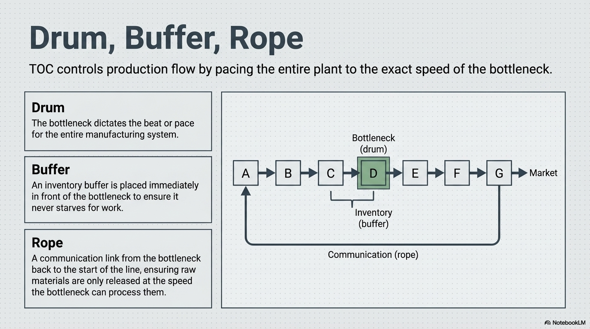

Slide 20
